Slide 1



Anycast in Context: A Tale of Two Systems
Thomas Koch, Ke Li, Calvin Ardi, Ethan Katz-Bassett, Matt Calder, John Heidemann
Notes:
Hi I’m Tom Koch, a PhD student at Columbia. This was a collaborative effort with researchers from USC and Microsoft.

Slide 2
Overview
Views of anycast performance differ
Some say anycast increases latency [1].
Others say anycast performs well [2].
What is going on?
To understand these differences, we study two different uses of anycast: DNS and CDN
By placing anycast in context, we find that anycast performance can be good when it matters.
[1] Zhihao Li, Dave Levin, Neil Spring, and Bobby Bhattacharjee. 2018. Internet Anycast: Performance, Problems, & Potential. In Proceedings of the 2018 ACM SIGCOMM Conference (Budapest, Hungary).
[2] Matt Calder, Ashley Flavel, Ethan Katz-Bassett, Ratul Mahajan, and Jitendra Padhye. 2015. Analyzing the Performance of an Anycast CDN. In Proceedings of the 2015 Internet Measurement Conference (IMC) (Tokyo, Japan).
Notes:
(CLICK)
So we noticed that some prior work painted anycast in a bad light -- that is, anycast often increases latency. At the same time you have other work showing that anycast rarely increases latency AND you have large latency-sensitive services spending millions on deployments that serve billions of people.
So naturally, we were confused. We went ahead and cleared up the confusion, by analyzing two systems that use anycast using both the same methodology and coverage so we could compare results. When we placed anycast performance in the context of the system, we realized that anycast performance can be quite good when it MATTERS to users.

Slide 3
Motivation
Background and Definitions
Root DNS and Microsoft’s CDN
Inflation in Anycast Deployments
Performance in Context
Investment and Incentive Shapes Deployments and Paths
Notes:
So with that brief overview, lets motivate the discussion a bit more thoroughly

Slide 4
Anycast in Practice
Many systems use anycast 1. DNS (roots, Akamai, Cloudflare, some public DNS) 2. CDNs (Microsoft, Verizon, Cloudflare) 3. Google
# of Sites
 | 2015 | Today
Microsoft’s CDN | 30 | 110
Root DNS | 500 | 1400
Deployments are growing
Deployments host latency-sensitive services Google Cloud VMs can host game engines!
Notes:
(CLICK)
Anycast is used by many systems on the Internet, each of which have different goals and system designs.
Deployments are also growing. Both Microsoft and the root DNS have more than doubled in size in the past 5 years.
These deployments also host some of the most latency-sensitive services there are: Google Cloud VM’s can host game engines which have very strict latency requirements

Slide 5
Anycast in Literature
Mixed Reviews
(Li et. al., SIGCOMM 2018) “While it is not surprising that IP anycast is suboptimal … we find [anycast’s] inefficiencies to be surprisingly excessive.”
(Calder et. al., IMC 2015) “For most clients, anycast performs well despite the lack of centralized control.”
Deployment investigated: the root DNS.
Deployment investigated: Microsoft’s anycast CDN.
Questions:
Why such different conclusions? Is it due to the deployments?
Why are deployments expanding if there’s “excessive inefficiency”?
Notes:
In the literature, we see some mixed reviews of anycast.
Quoted here are two papers from major conferences within a few years of each other that arrive at two very different conclusions. One study says anycast’s inefficiencies are surprisingly excessive while the other says anycast performs well despite the lack of centralized control.
However, they evaluated different types of deployments, and used different methodology so its difficult to compare results and arrive at a clear picture of anycast performance. This led us to ask a couple questions.
First, why are there different takeaways in the literature about anycast performance? In particular, do the deployments have anything to do with the different results?
And, why are anycast deployments expanding if anycast hurts performance?

Slide 6
Contributions
Analyzing root DNS and Microsoft’s anycast CDN we show
Anycast performs poorly in root DNS, but well in Microsoft.
Latency hardly matters for root DNS since caching is so effective.
Latency matters a lot for Microsoft since users frequently traverse paths.
Microsoft optimizes performance by investing in strategic (and expensive!) peering agreements.
Notes:
(CLICK)
So to answer these questions, we analyze two systems that use anycast (root DNS and Microsoft’s CDN) and make the following main contributions. First, we find that the root DNS specifically has poor anycast performance, but anycast performs well for Microsoft. PAUSE Second, we show that root DNS performance hardly matters to users, since caching of root DNS records is so effective. PAUSE
On the other hand, performance is quite important in Microsoft’s CDN, since users frequently traverse paths to Microsoft. PAUSE
Finally, we provide evidence that Microsoft keeps performance good by peering closely with end user networks, which shortens paths between users and content. PAUSE

Slide 7
Motivation
Background and Definitions
Root DNS and Microsoft’s CDN
Inflation in Anycast Deployments
Performance in Context
Investment and Incentive Shapes Deployments and Paths
Notes:
We’ve been a little high level about what we mean by “good” and “performance” and “efficiency”, so let’s discuss what all these terms mean.

Slide 8
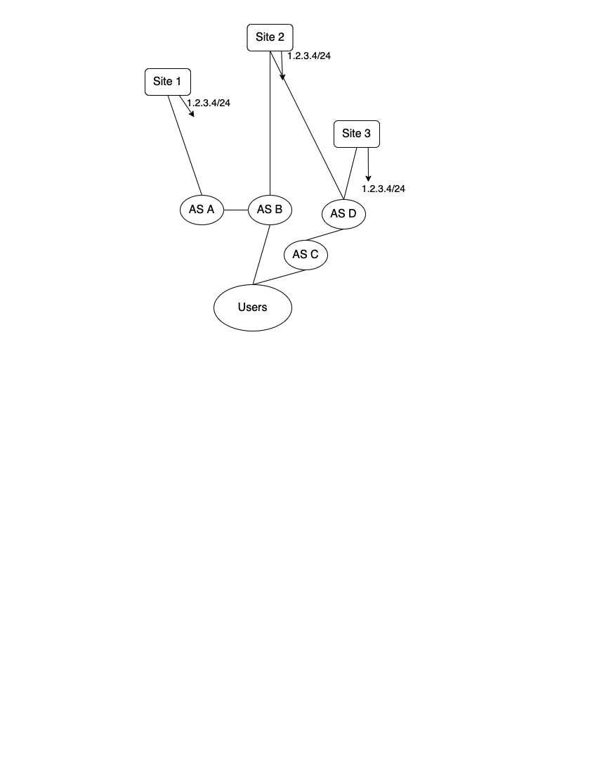
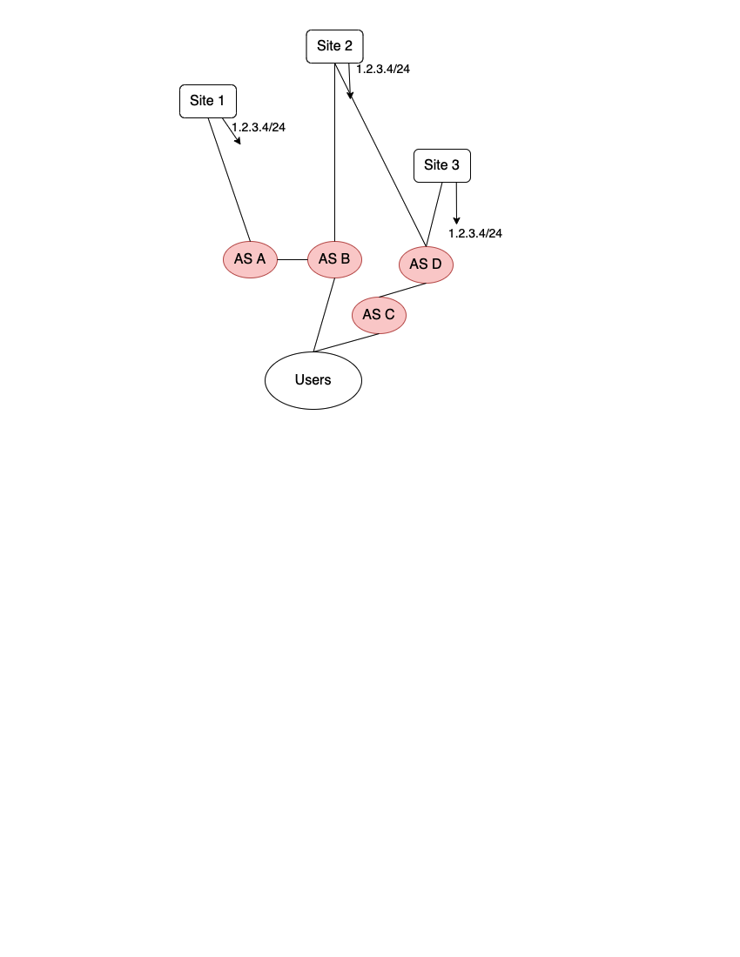
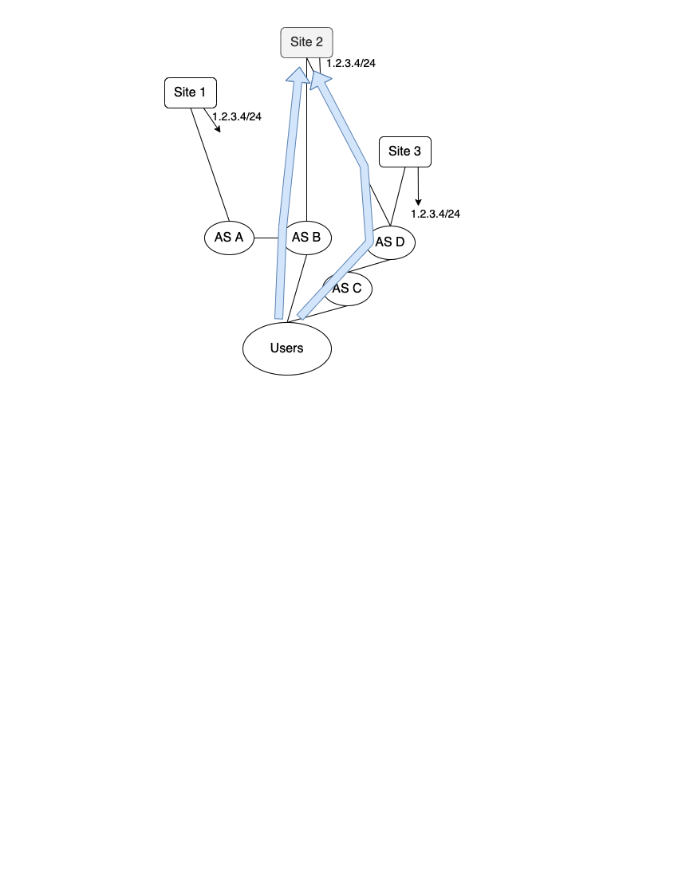
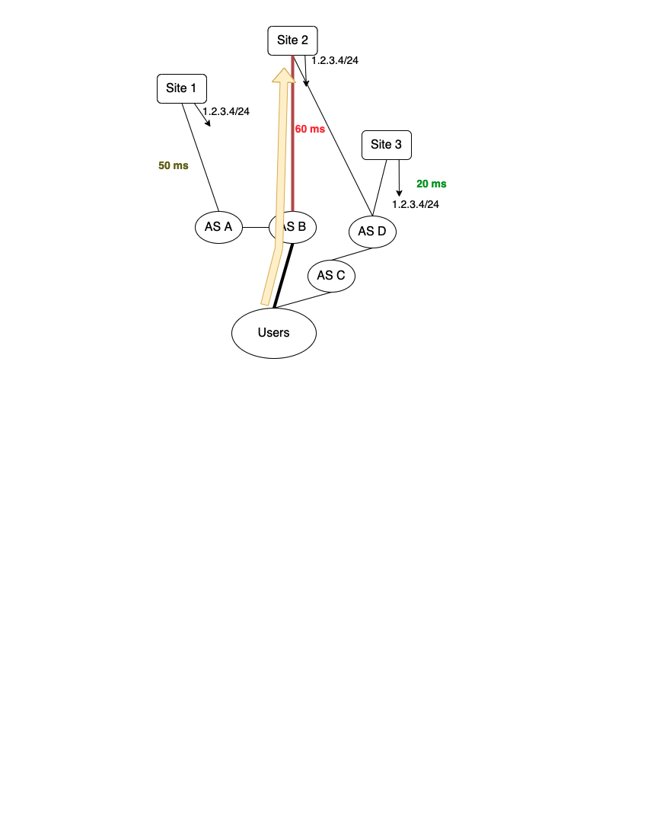
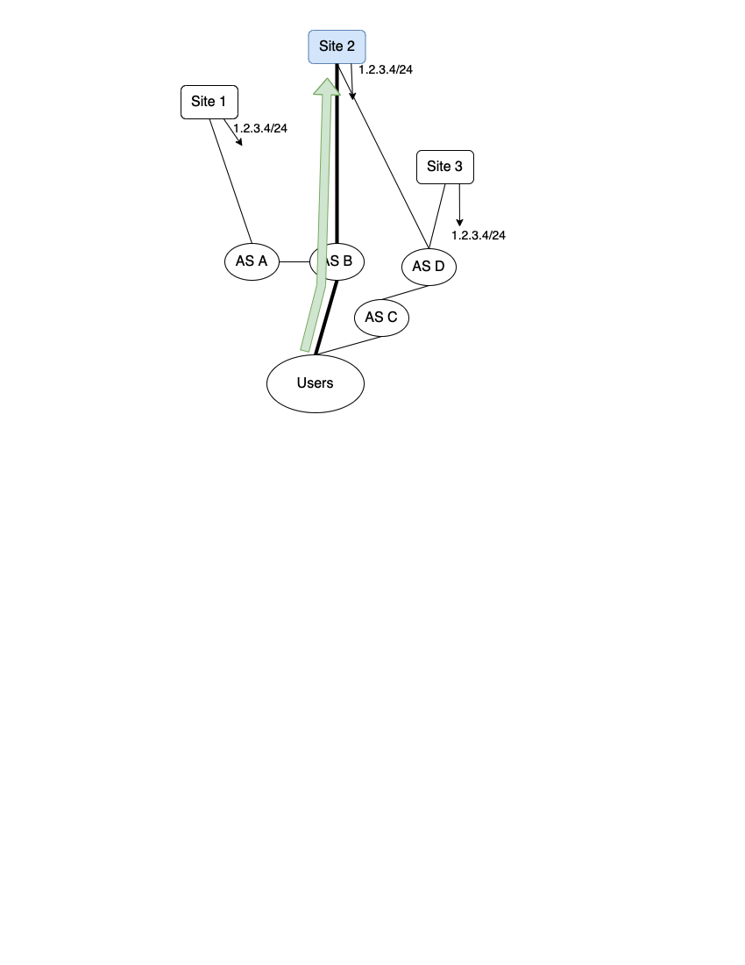
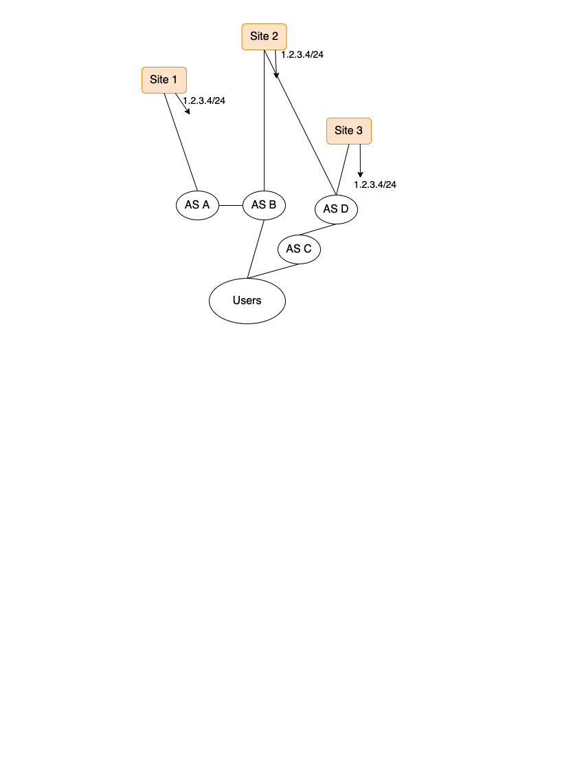
What is IP Anycast?
An approach to routing, where distinct servers (sites) all use the same IP address and serve the same content.
The set of sites is the deployment.
Inflation: BGP does not incorporate performance into its decision-making process, so users may take unnecessarily high latency paths.
Routes to sites are selected via BGP.
Potential Benefits of Anycast 1. Simple, scalable content distribution. 2. Seamless handling of certain types of site failure / route withdrawals. 3. DDoS protection.
Users incur 60 ms reaching site 2, even though site 3 offers lower latency.
The route from a network of users to 1.2.3.4/24 is selected (via BGP) to be the route through AS B to Site 2.
Notes:
First, what is IP anycast? (DOUBLE CLICK)
IP anycast is an approach to routing, where servers (which we call sites) all use the same IP address and serve the same content. The set of sites is called a deployment.
In this figure,
you can see a deployment with three sites in three distinct locations all advertising the same prefix,
and they’re connected to a network of users by way of ASes A through D. Not only can the network of users reach three different sites to get the same content,
but the network also has many paths to each of these three sites given its connectivity to other ASes.
The route from the network of users to a site is selected via BGP, which takes into account properties such as local preference and AS path length.
In this example, users reach site 2 through AS B.
Anycast provides many benefits including scalability, simple handling of certain types of failure, and DDoS protection. So, is anycast all good? Not quite. Since BGP doesn’t take performance into account when making decisions about which routes to select, users may take unnecessarily high latency paths. This phenomenon is called inflation. Users here reach site 2 in 60 ms, but the path to site 3 is 20 ms, so these users would benefit from instead reaching site 3. PAUSE

Slide 9
How Prior Work Calculates Inflation
Prior Work [1-4]: Inflation = Achieved - best alternative = 60 ms - 20 ms = 40 ms
Limitations of this approach:
1. Measuring the “20 ms” path would sacrifice coverage.
2. The “20 ms” path may still be inflated!
[1] Hitesh Ballani and Paul Francis. 2005. Towards a Global IP Anycast Service. In Proceedings of the 2005 ACM SIGCOMM Conference (Philadelphia, PA, USA). [2] Matt Calder, Ashley Flavel, Ethan Katz-Bassett, Ratul Mahajan, and Jitendra Padhye. 2015. Analyzing the Performance of an Anycast CDN. In Proceedings of the 2015 Internet Measurement Conference (IMC) (Tokyo, Japan).
[3] Ricardo de Oliveira Schmidt, John Heidemann, and Jan Harm Kuipers. 2017. Anycast Latency: How Many Sites Are Enough? In International Conference on Passive and Active Network Measurement (PAM) (Sydney, Australia).
[4] Zhihao Li, Dave Levin, Neil Spring, and Bobby Bhattacharjee. 2018. Internet Anycast: Performance, Problems, & Potential. In Proceedings of the 2018 ACM SIGCOMM Conference (Budapest, Hungary).
Users incur 40 ms extra compared to the best alternative.
Notes:
We measure inflation in our paper, but do it a bit differently than prior work.
Prior work calls inflation the difference between achieved and best unicast alternative latency. Let’s look at the figure for an example calculation of how prior work calculates inflation. The latency to site 2 is 60 ms, and the lowest alternative is the latency to site 3 -- 20 ms. So the inflation calculation would be the difference between 60 and 20 which is 40 ms.
However,
you need a lot of vantage points to measure these “alternate latencies” (the 20 ms path), so we’d sacrifice coverage if we calculated inflation this way. For example, one could use RIPE Atlas, but RIPE Atlas only has vantage points in about 3000 networks. This compares to the 50,000 networks we cover in this study.
Moreover, the “20 ms” path might still be inflated, and so we even with full coverage we might not capture all the inflation. For example, the path to site 3 may be unnecessarily circuitous. PAUSE

Slide 10
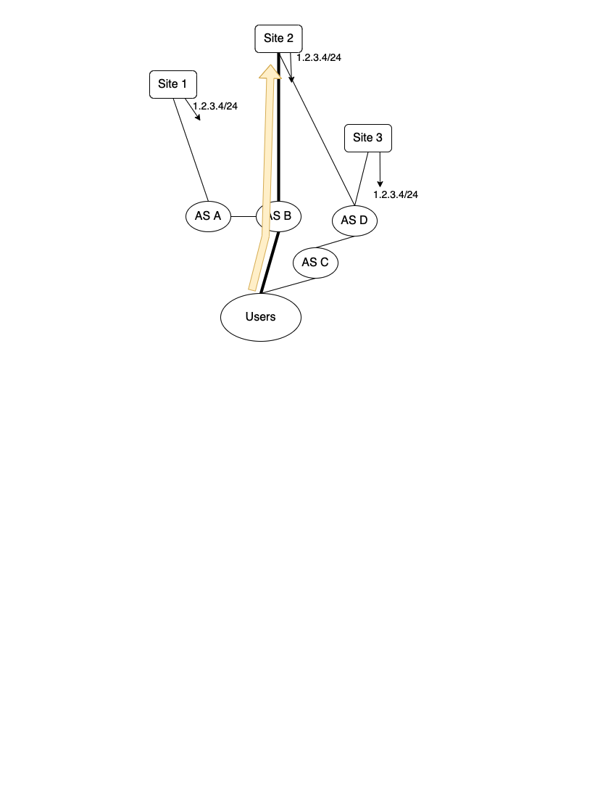
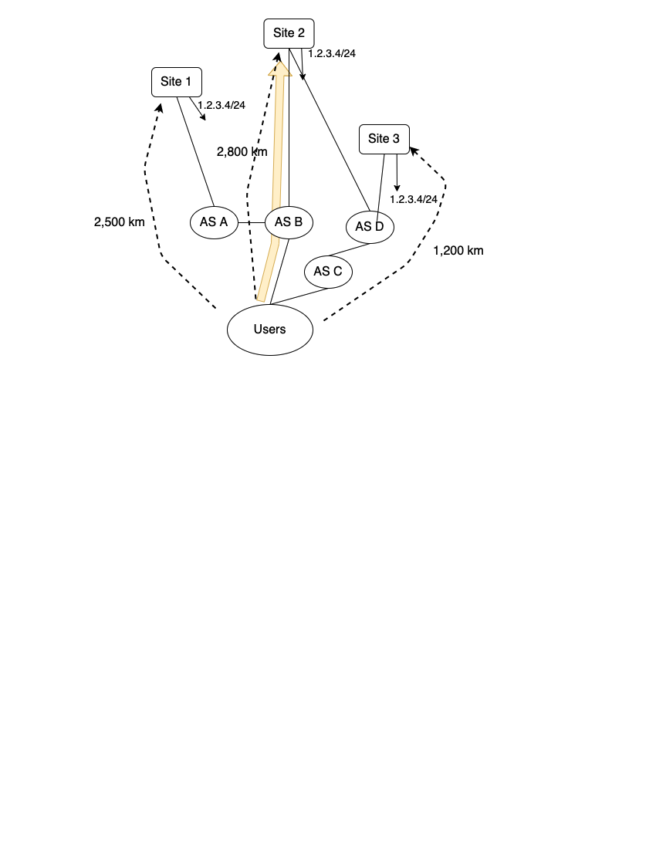
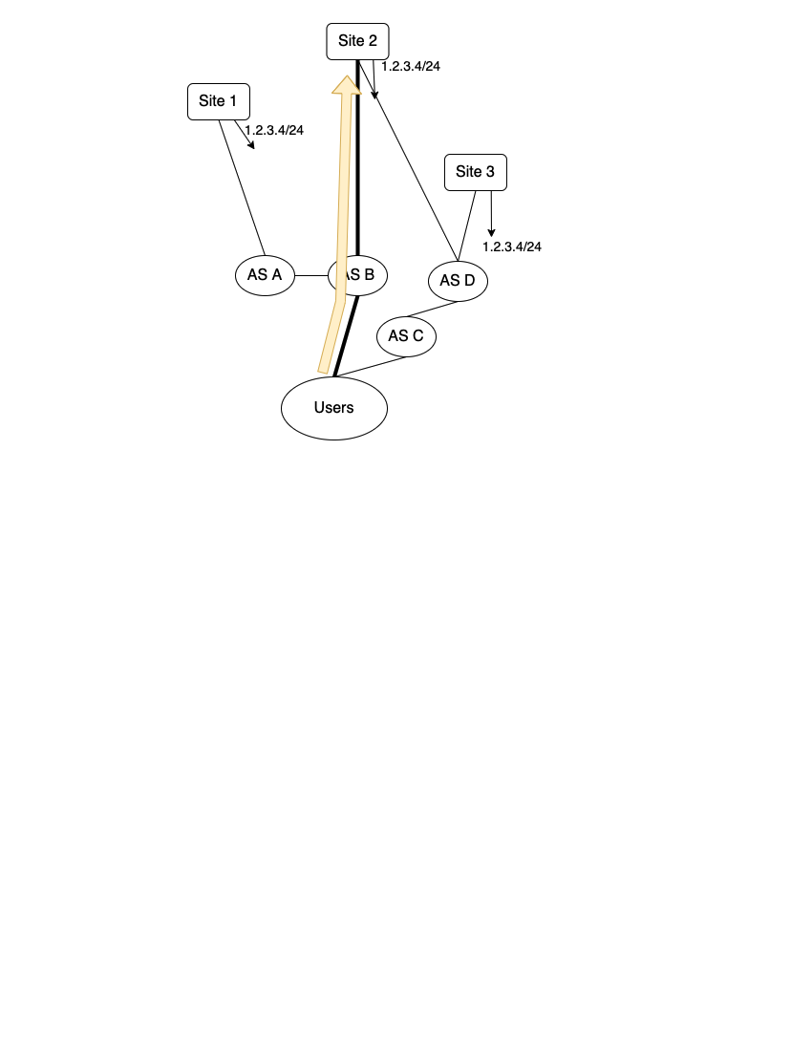
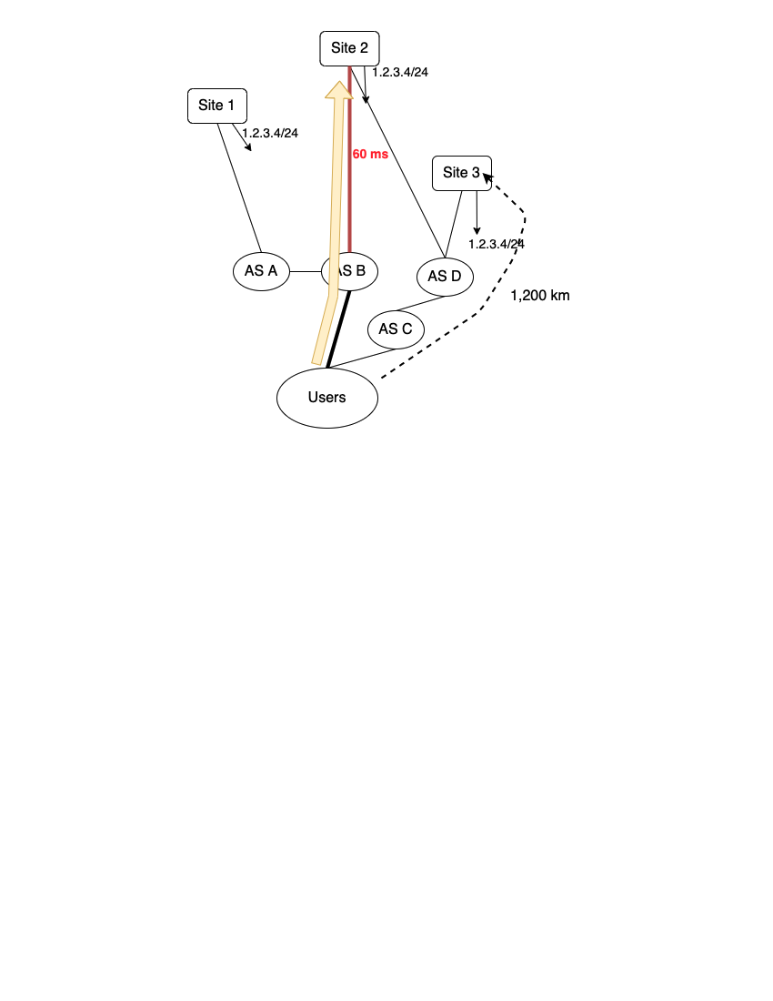
How We Calculate Inflation
1. Geographic Inflation: Extra Distance
( 2,800 km - 1,200 km = 1,600 km )
2. Latency Inflation: Extra Latency over Reasonable Lowest Latency
( 60 ms - 1,200 km * 1.5 * 1 ms / 200 km = 51 ms)
Notes:
Instead, we use two complementary measures of inflation, which we can calculate with broad coverage. First, geographic inflation, which is the extra great-circle distance queries travel over the closest site. Geographic inflation gives us a rough measure of “efficiency”, since not hitting the closest site implies that we may not be taking full advantage of the deployment. However, geographic inflation is a little simplified. For example, geographic inflation does not take into account the constraints of the physical Internet such as the physical fiber paths.
Let’s look at an example. Recall that the set of users goes through AS B to reach site 2. Assume that the distances from the users to each of the sites are as shown by the dotted lines. In this example, the inflation is 2,800 km to site 2 minus 1,200 km which is the distance to the nearest site (site 3). Hence the geographic inflation is 1,600 km.
Second, latency inflation, is the achieved latency minus a reasonable lowest alternative latency. We say the reasonable lowest latency is 1 and a half times the great circle distance, converted to the speed of light in fiber. We selected this lower bound for technical reasons, which you can read more about in the paper. Although the lower bound is a little simplified, this measure allows us to take into account real world effects like circuitous paths since we use actual latency measurements from the root DNS and CDN, unlike in our geographic inflation calculation.
In this example, the latency to site 2 is 60 ms, and the distance to the nearest site is 1,200km. This yields a latency inflation of 51 ms. PAUSE

Slide 11
Motivation
Background and Definitions
Root DNS and Microsoft’s CDN
Inflation in Anycast Deployments
Performance in Context
Investment and Incentive Shapes Deployments and Paths
Notes:
With these definitions under our belt, let’s discuss the two systems -- the root DNS and Microsoft’s CDN.

Slide 12
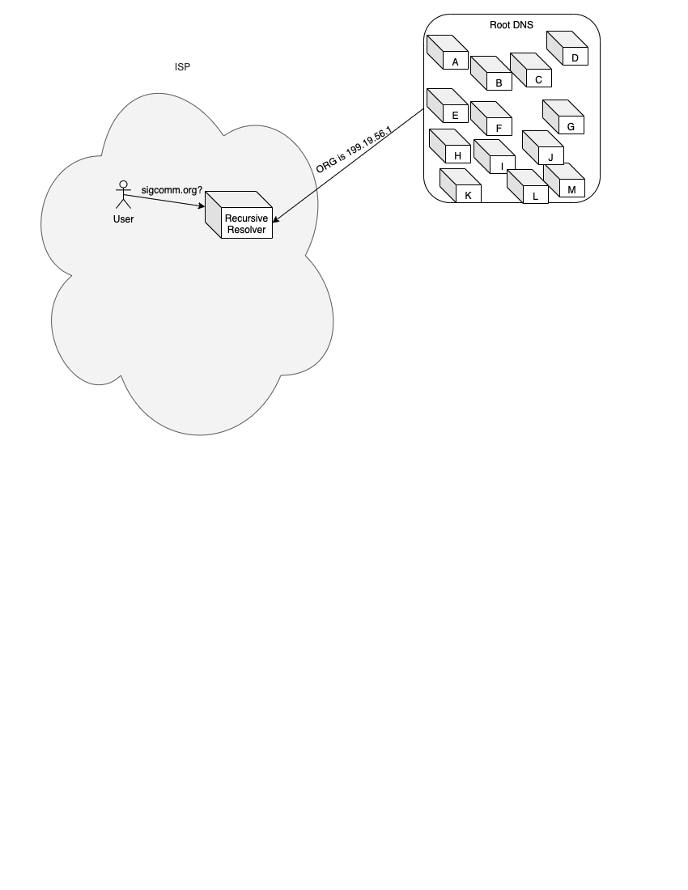
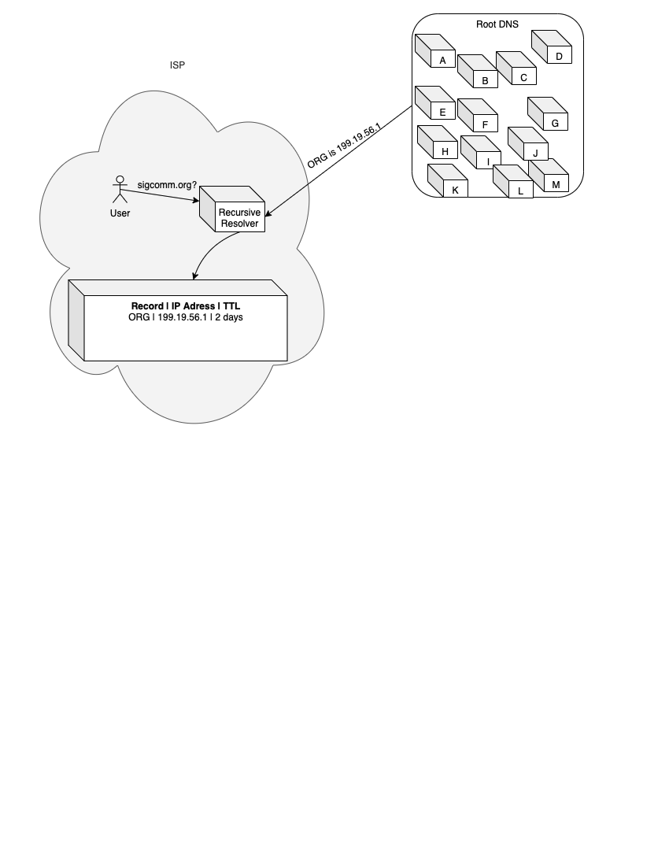
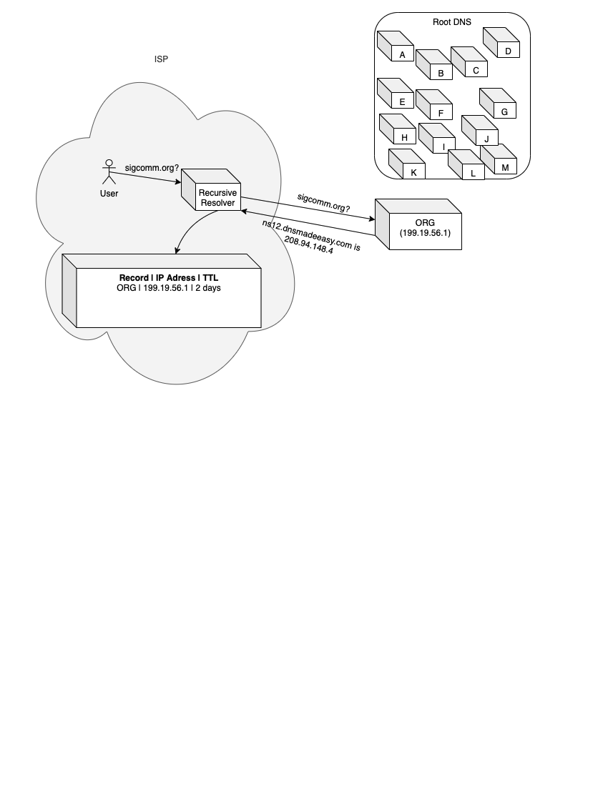
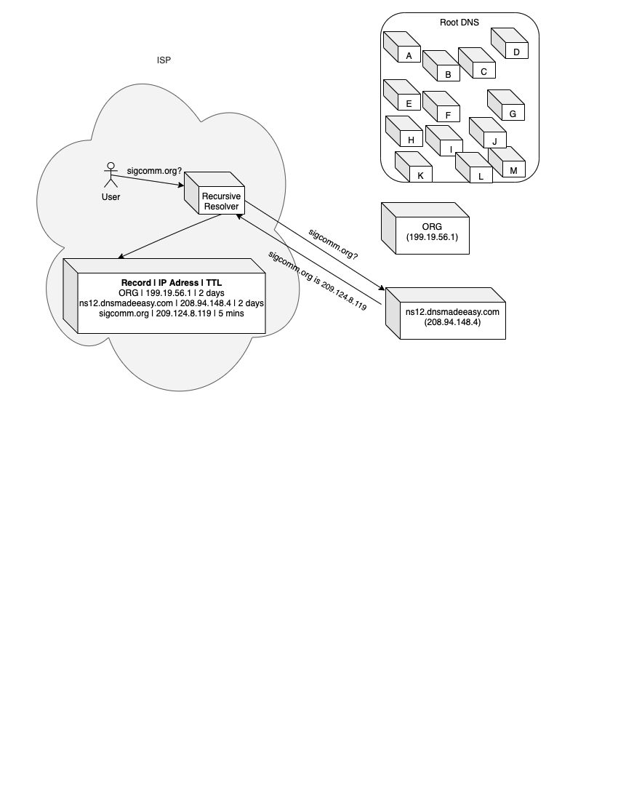
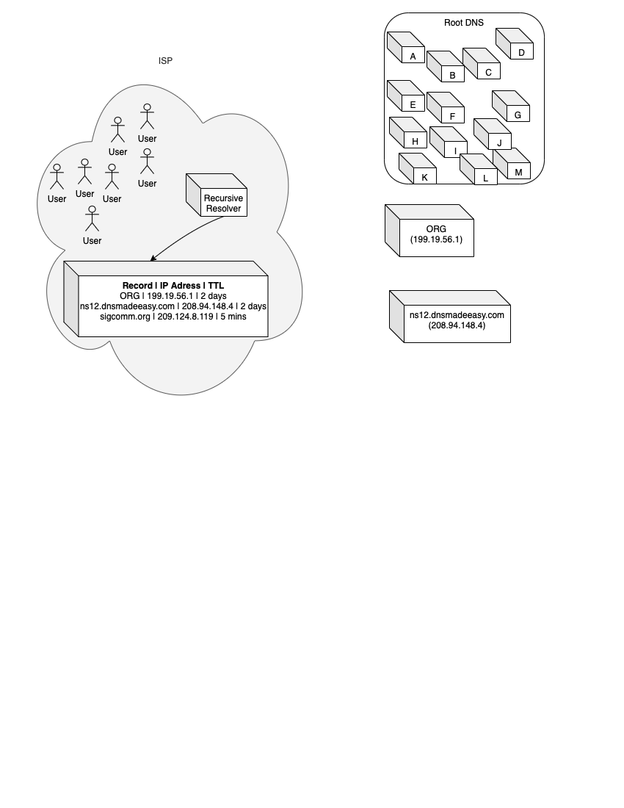

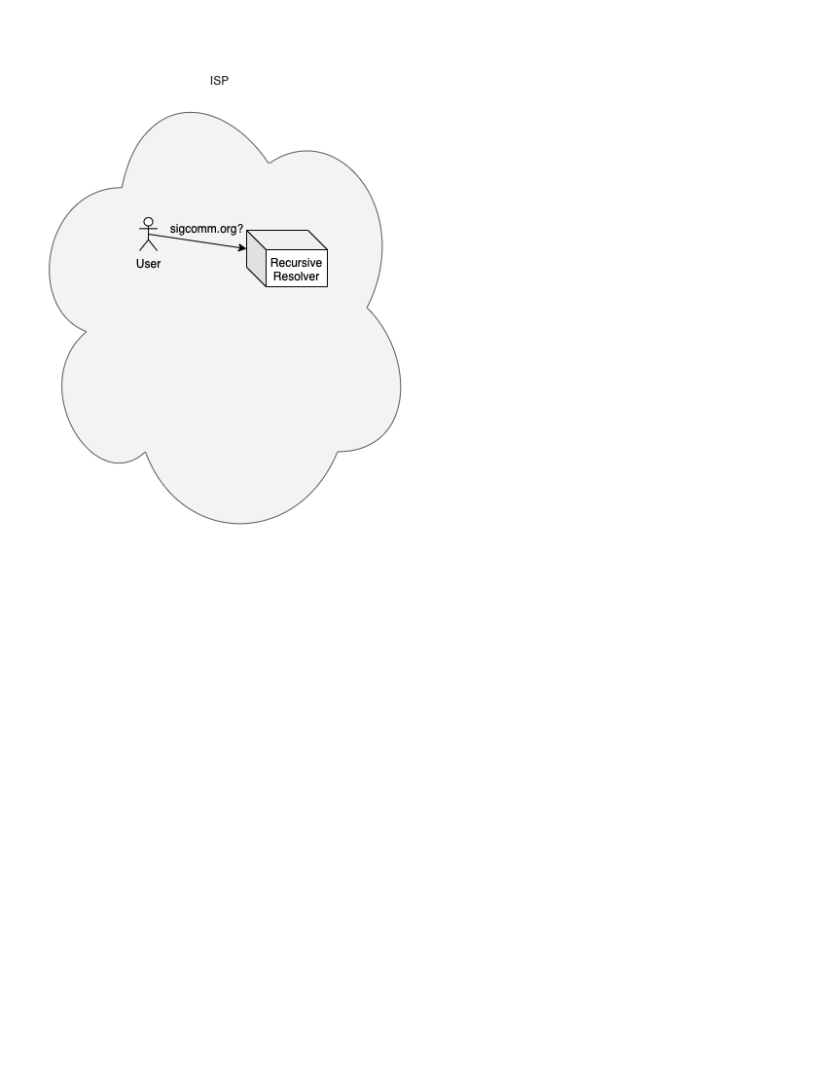
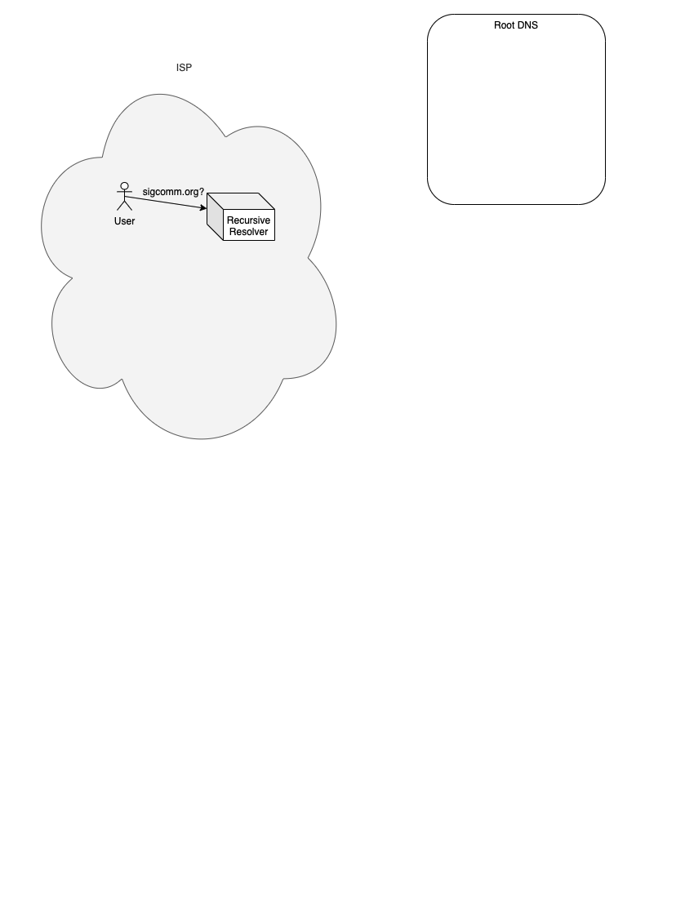
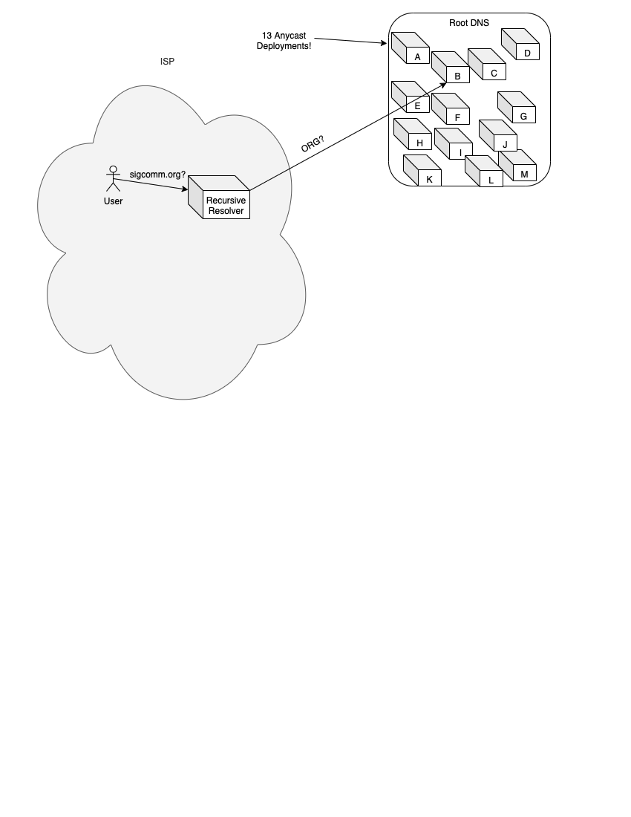

What is the Root DNS?
Notes:
First, what’s the root DNS? An easy way of understanding the root DNS, is to walk through the process of DNS resolution.
It all starts with a user. The user wants to resolve a human-readable name, like sigcomm.org, to the IP address where sigcomm.org can be found. This user is in an ISP. The ISP likely tells the user where to find its recursive resolver, through DHCP. The recursive resolver will likely be shared with other users in the ISP in a metropolitan area. The user asks the recursive resolver about sigcomm.org. Let’s assume that the recursive resolver just turned on, and it knows nothing about the world except where to find the root DNS server. The recursive resolver will query the root DNS, asking about the Top Level Domain (or TLD, for short). The root DNS is a group of 13 anycast deployments (referred to by letters of the alphabet), run by different organizations. The anycast deployments consist of anywhere from 6 to 250 sites.
The recursive resolver can choose whichever root letter it wants to query, since each letter deployment provides an identical service. Maybe it picks the one with lowest latency. In this case, the recursive resolver chose to ask B root, where it can find the ORG TLD, since the user is asking about sigcomm DOT ORG.
The root server replies with the answer The recursive resolver then stores this answer in its cache. Nearly all records from the root servers have a TTL (which is a time to live) of 2 days, which means the recursive resolver can store that record for up to 2 days before it needs to refresh it. Shown in the image is the recursive resolver’s cache. We have the record, the IP address of that record, and its TTL. Now the recursive resolver asks the ORG TLD where to find sigcomm.org. ORG answers with the authoritative nameserver hosting sigcomm. The recursive resolver also stores this record in its cache.
Finally, the recursive resolver asks the authoritative where to find sigcomm.org, and the recursive resolver gets the final answer (which it can forward to the user). Usually, these recursive resolvers (and therefore their caches) are shared among users in an ISP, say in a large metropolitan area. Hence, the chance that a user has to wait for a root DNS query is very small, since there is (ideally) one query per TLD every 2 days among the entire set of users, and since there are only about 1000 TLDs. The root DNS is an interesting deployment to investigate, since it features in prior work, it’s a really important service, and it lets us study 13 different strategies for offering the same service.

Slide 13
Data from the Root DNS
Concurrent captures from nearly all sites for nearly all root letters.
Global picture of who is querying the root DNS, how often they do it, and what they ask about.
From TCP DNS queries, we extract RTTs to measure latency.
Queries are from more than 50,000 ASes.
Notes:
(CLICK)
We used concurrent packet captures for 2 days from nearly all root letters.
These packet traces tell us who is querying the root DNS, how often they query, and which sites they’re hitting. From TCP DNS queries in particular, we can extract latency from recursive resolvers to sites, which we use to calculate latency inflation.
Measurements come from queriers in more than 50,000 ASes, giving us broad coverage.

Slide 14
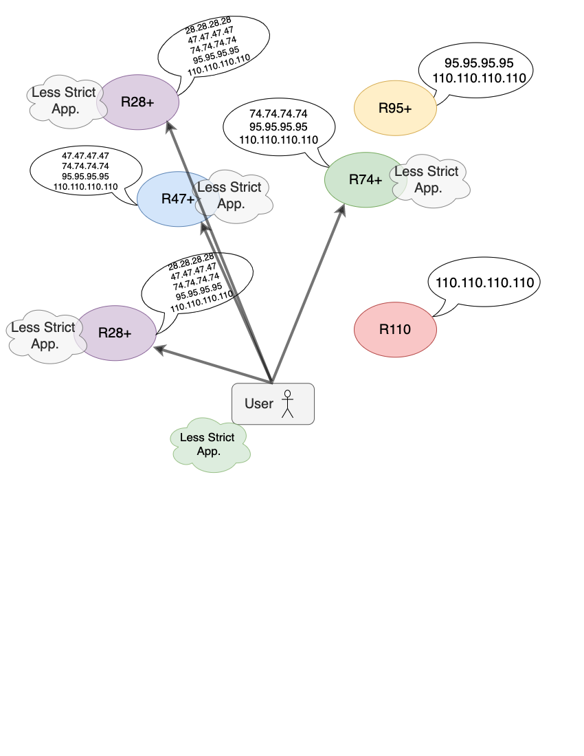
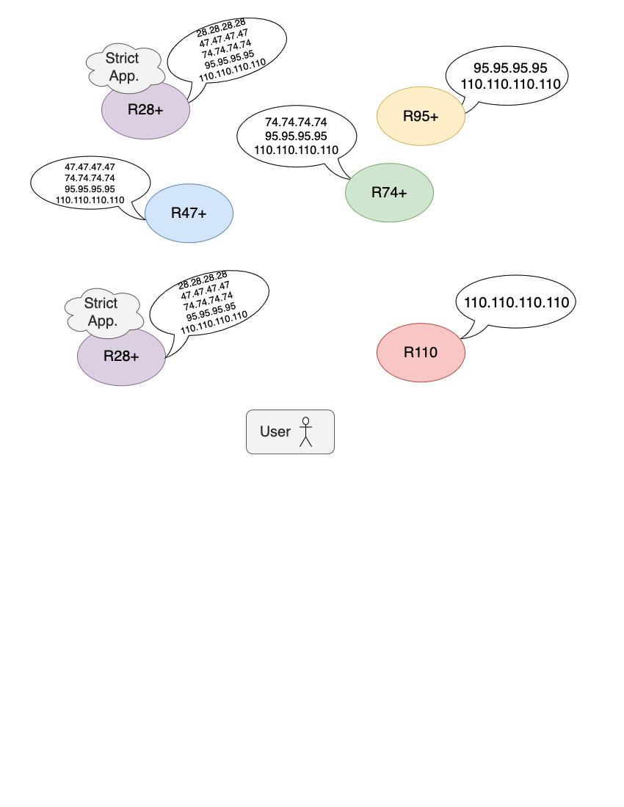
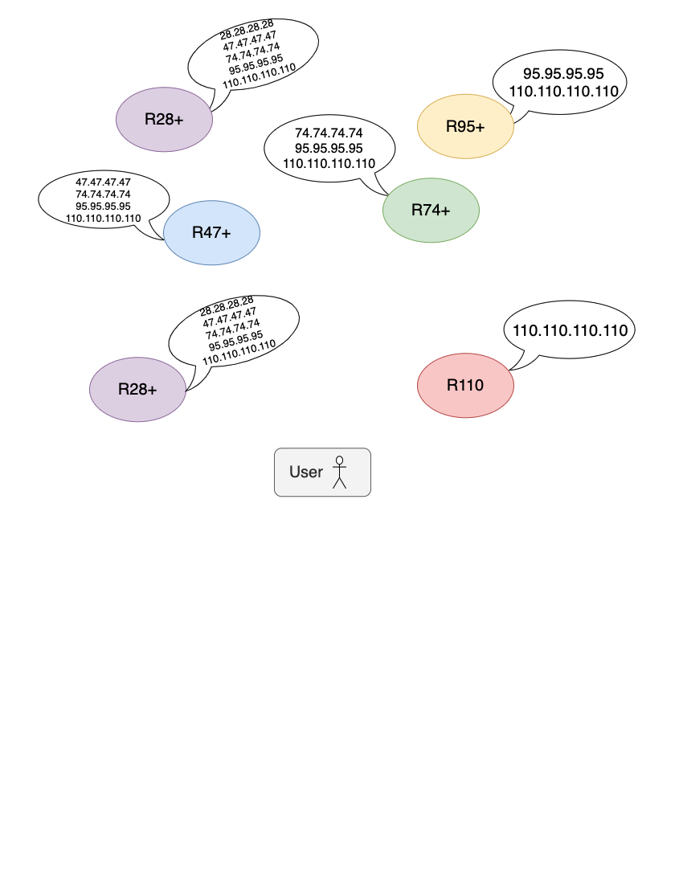
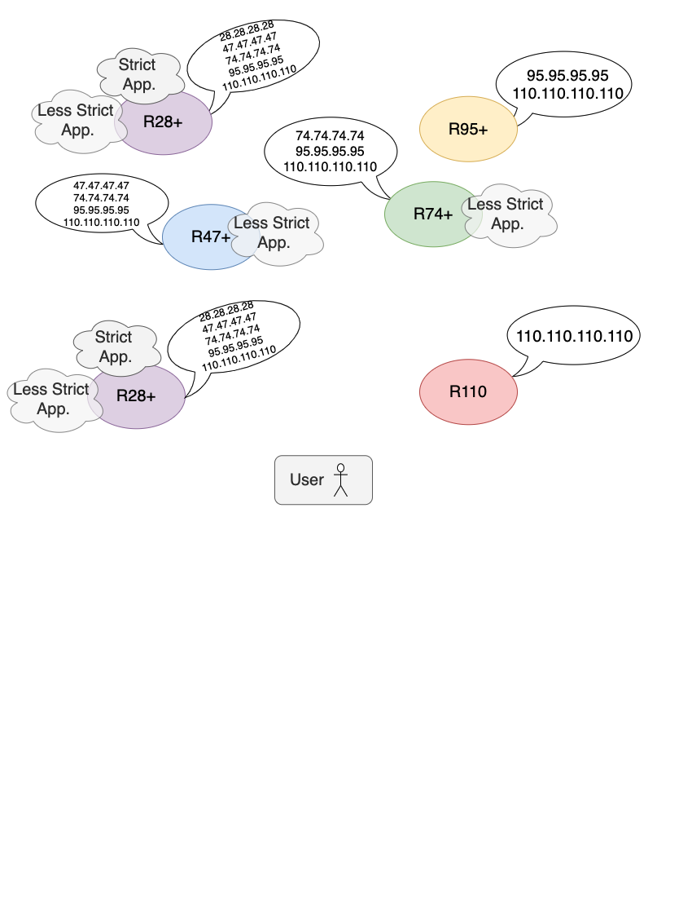
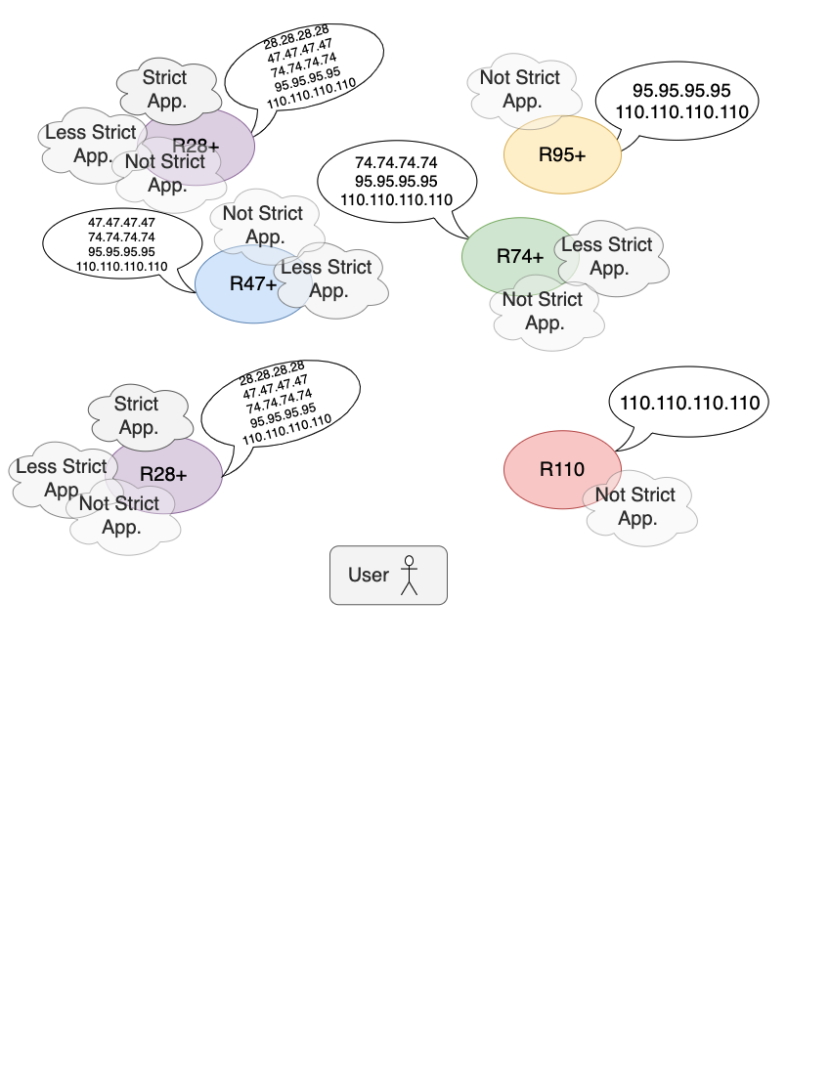
Microsoft’s Anycast CDN
A purely anycast CDN with 110 sites categorized into 5 rings.
Each ring is an anycast network.
Rings are separated by regulatory restrictions.
Notes:
We also study Microsoft’s purely anycast CDN.
It has 110 sites, and the sites are categorized into 5 “rings”. Each ring gets its own IP address. We refer to the rings according to the number of sites they have. Rings are distinguished by the regulatory requirements they abide by, with the smallest ring having the strictest requirements. The rings have the property that a site in a smaller ring is also in all larger rings, which is why smaller rings announce more addresses. For example, all sites in R28 (which has 28 sites) are also in R74 ( which has 74 sites), so all sites in R28 advertise both the 28 address and the 74 address, but not vice-versa. Different applications must abide by these different regulatory restrictions. An application is deployed on all sites for the largest ring that meets its regulatory needs, and it will be served from an anycast IP address belonging to that ring. So a strict application, such as enterprise email, may only be in R28.
Then a less strict application could additionally be in R47 and R74. Finally an app with no restrictions, such as search, could be served from all rings.
Users are directed to rings based on the application they’re trying to use since applications may have these different regulatory restrictions. When a recursive resolver queries for a Microsoft domain, only the application (as opposed to performance) is taken into account when returning an anycasted address .

Slide 15
Data from Microsoft’s Anycast CDN
Microsoft user counts (number of IP addresses)
Latency measurements from users to all rings.
Measurements are from more than 50,000 ASes.
Notes:
(CLICK)
We obtain user counts from Microsoft, who approximates user counts by counting distinct IP addresses.
Server side logs and client-side measurements give us latency measurements from users to sites for all rings.
Microsoft measurements are also from more than 50,000 ASes, giving us equally broad coverage.

Slide 16
Motivation
Background and Definitions
Root DNS and Microsoft’s CDN
Inflation in Anycast Deployments
Performance in Context
Investment and Incentive Shapes Deployments and Paths
Notes:
So now that we have sufficient background, let’s jump into some results

Slide 17
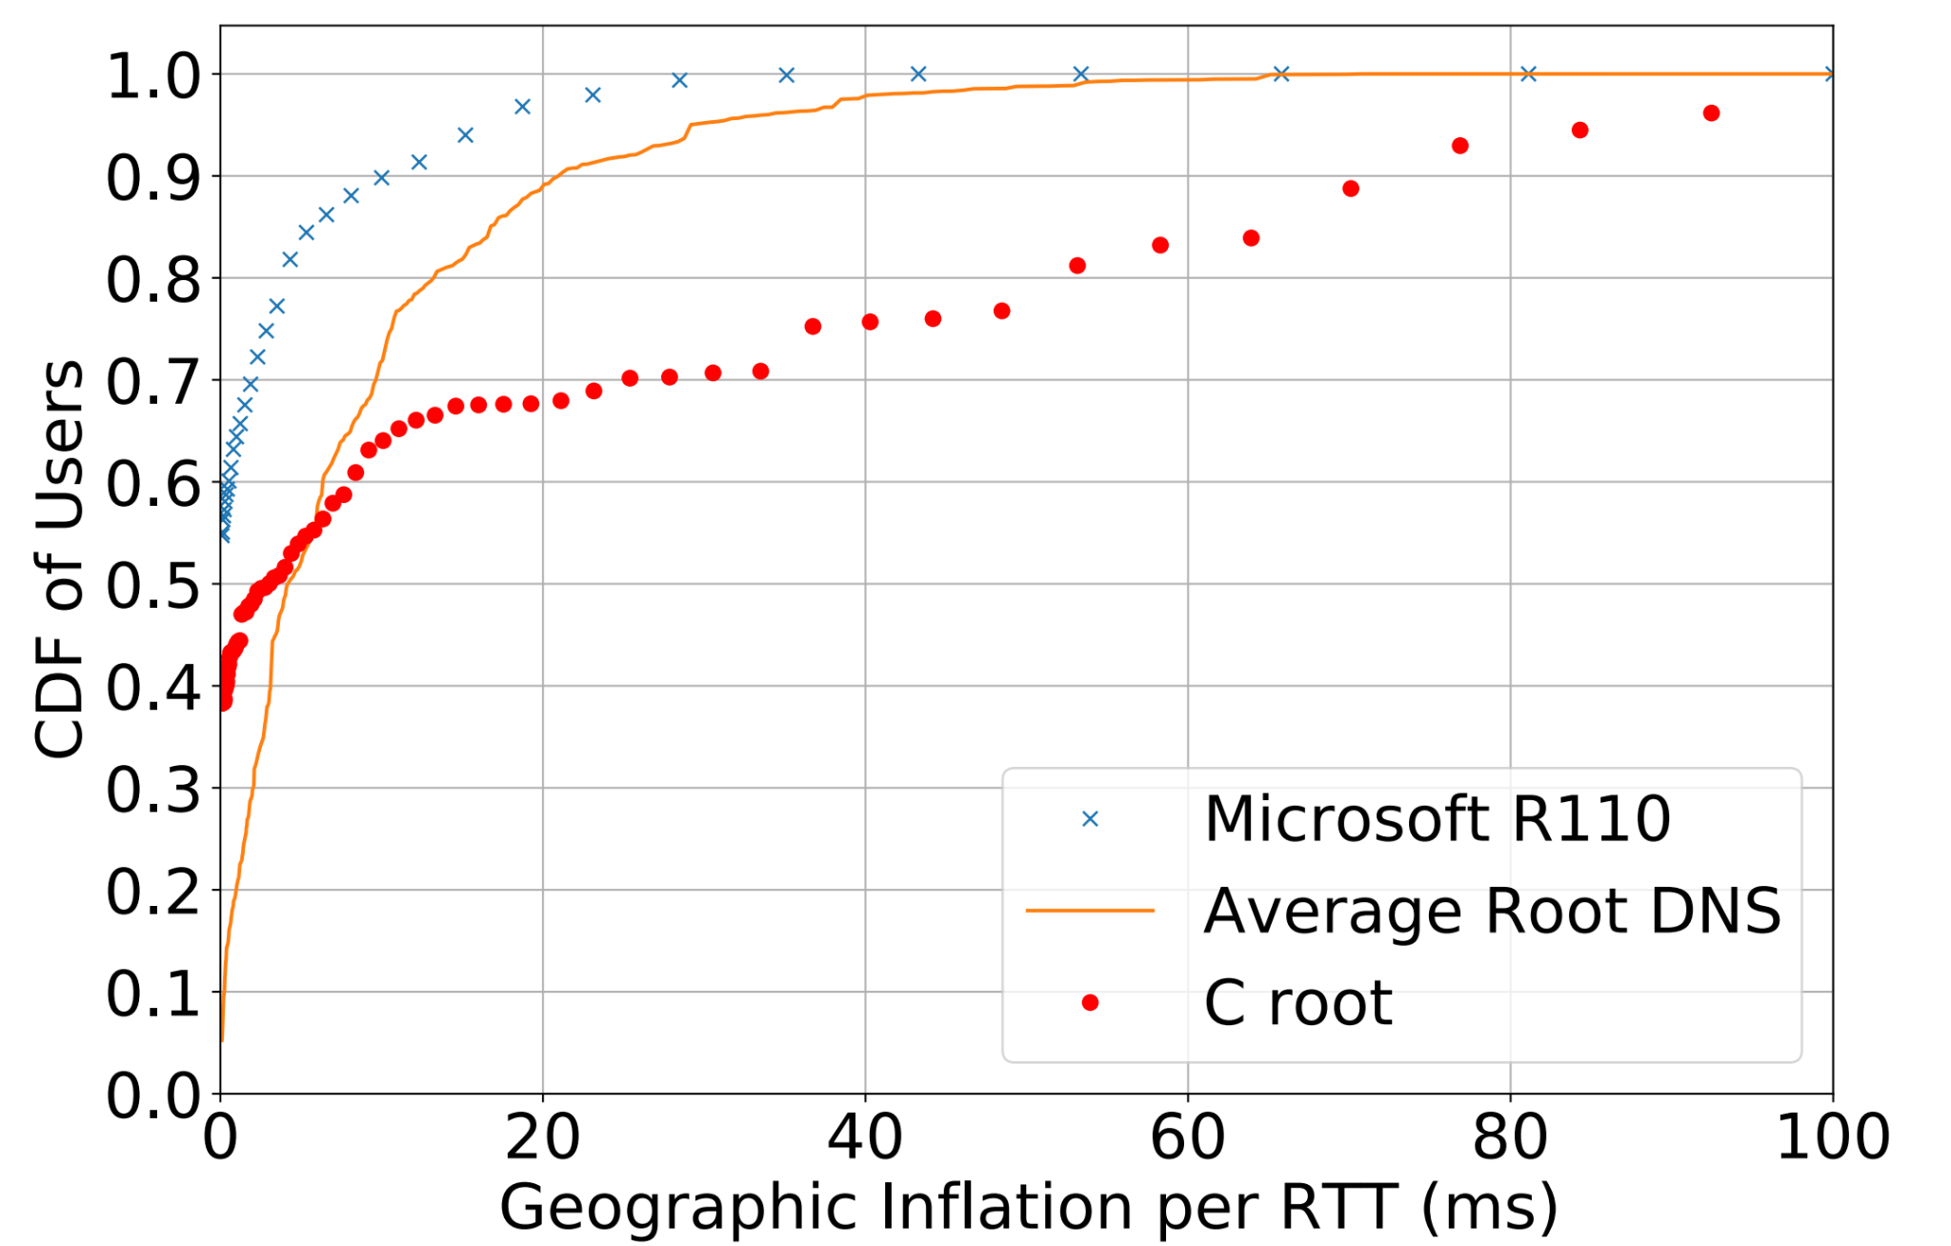
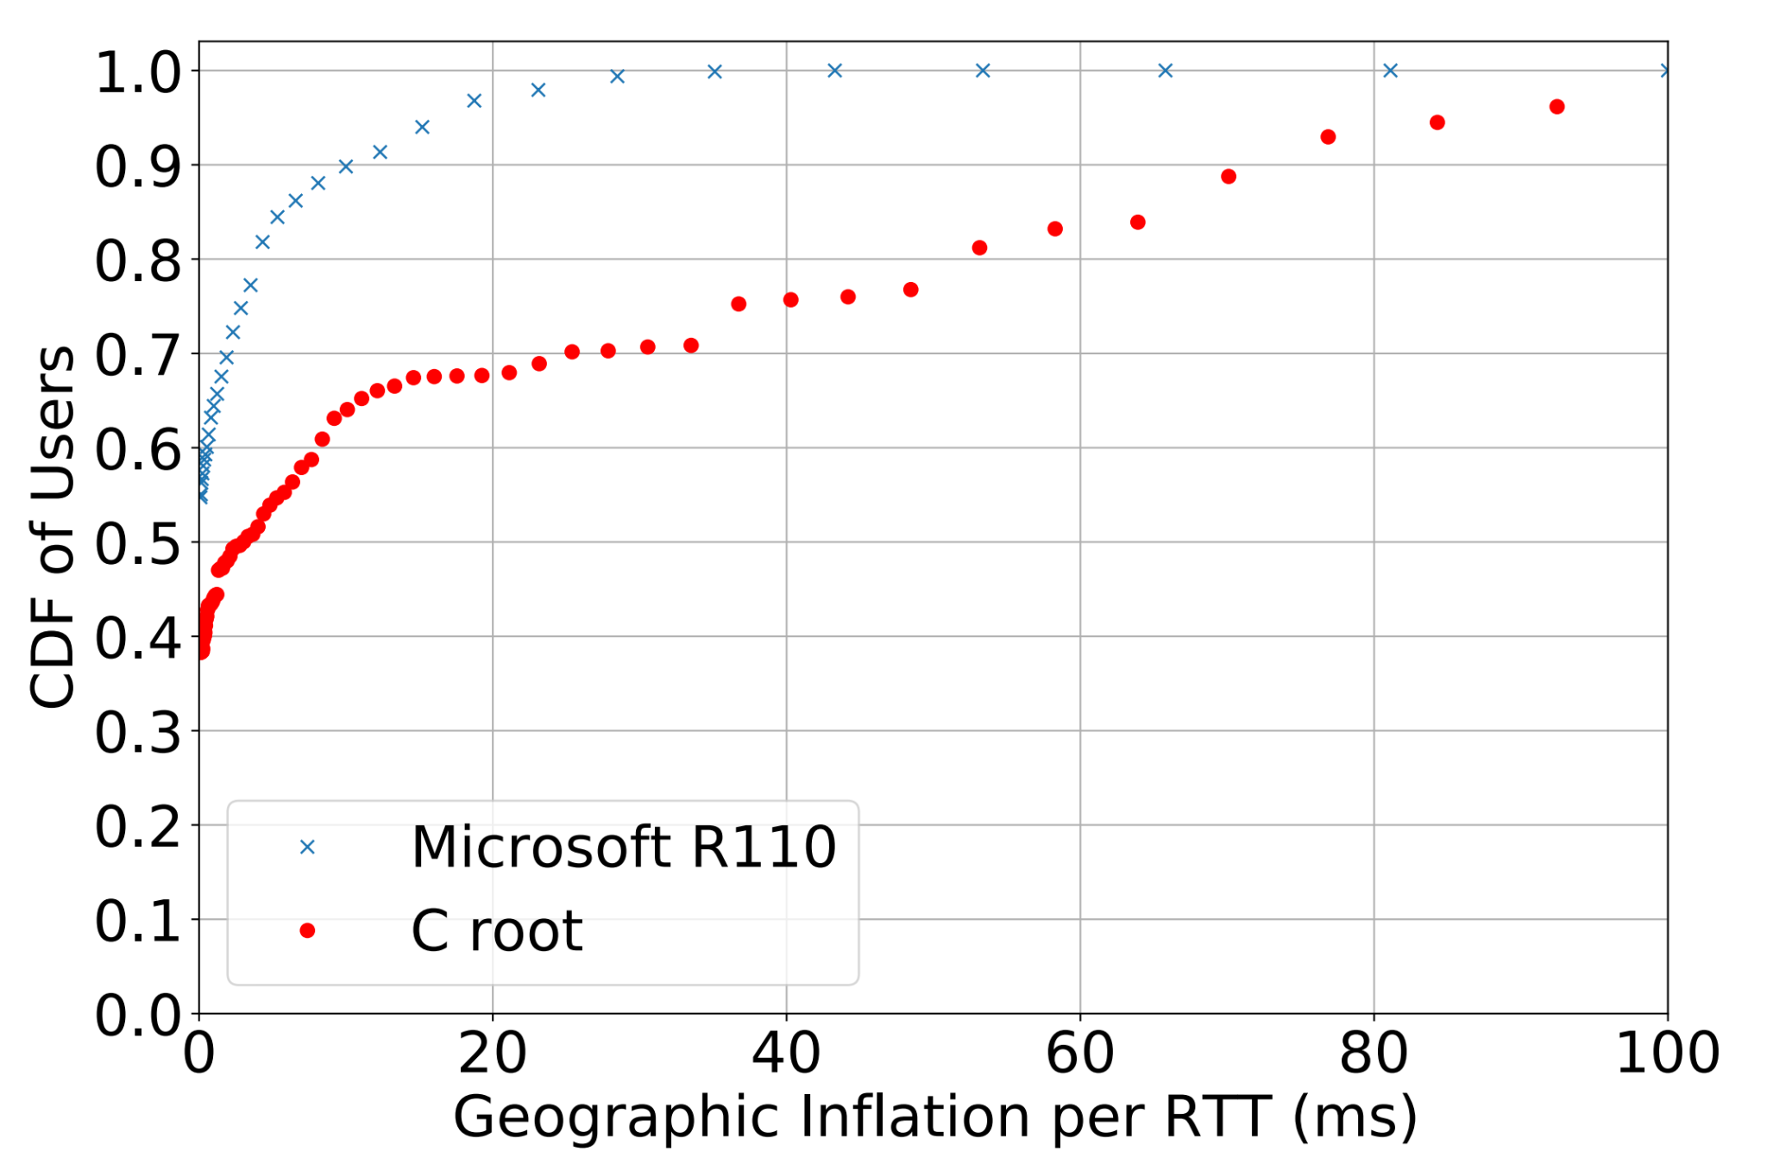
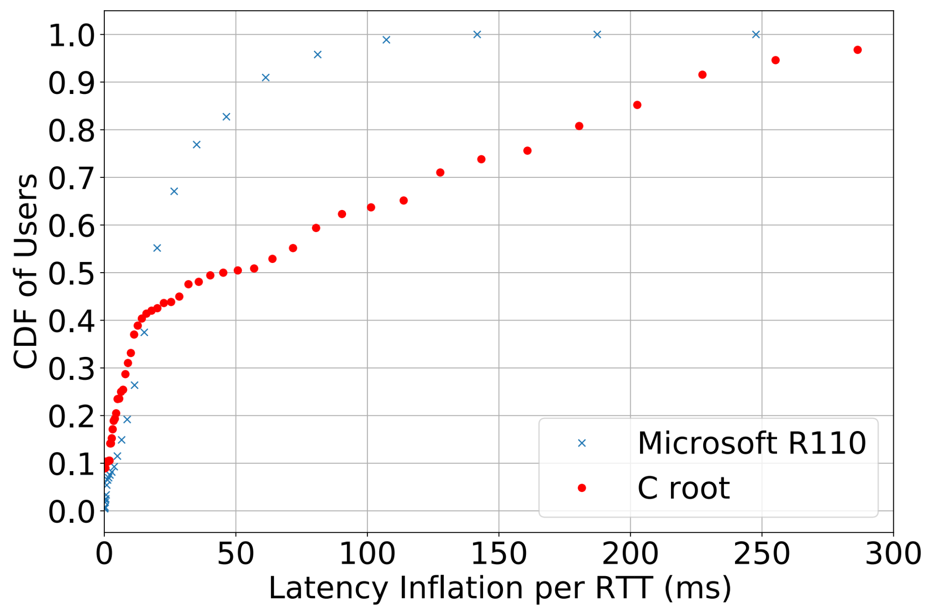
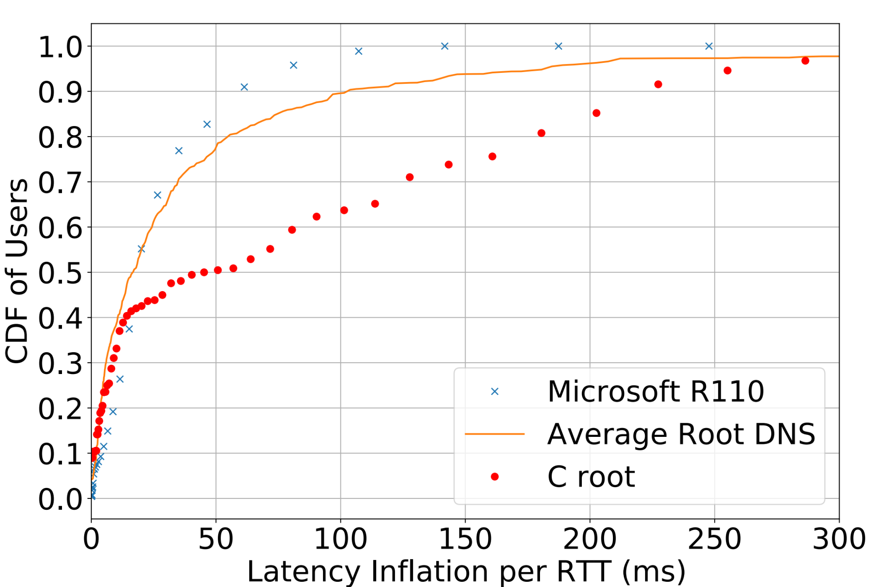
Inflation in the Root DNS and Microsoft’s CDN
Geographic Inflation
Latency Inflation
1. Individual root letters have lots of inflation (e.g., C root), Microsoft’s is much lower.
2. Microsoft’s inflation is quite low, despite massive growth in its deployment.
3. Average root DNS inflation is not as bad as in individual letters.
4. Studying both types of inflation is valuable.
Notes:
First, our results on inflation.
We calculated the two types of inflation we previously mentioned: geographic and latency. Both plots show CDFs of inflation for Microsoft’s largest ring in blue x’s, and C root’s inflation in red dots (C root is representative of other root letters). On the left, we have geographic inflation which shows the extra distance queries travel, scaled to latency by the speed of light in fiber. On the right, we have latency inflation which takes into account real world effects like circuitous paths.
For example the point at (50, .5) circled in red means that 50% of users experience at most 50 ms of latency inflation.
For individual letters (for example, C root) both types of inflation are quite large --
much larger than in Microsoft’s CDN. For example, the red circles show that 65% of users experience less than 100 ms of latency inflation to C root, but 98% of users experience less than 100 ms to Microsoft.
We also calculate average root DNS inflation as shown by the solid orange line. The average inflation to the root DNS for a recursive resolver is the average inflation the recursive experiences to each root letter, weighted by how often the recursive resolver queries each root.
Looking at the double-sided yellow arrow on the right plot demonstrates that selective querying of root letters has a noticeable effect -- for example, 65% of users experience less than 100 ms of latency inflation to C root, but NINETY% of users experience less than 100 ms of latency inflation when querying the root DNS on average. Average root DNS inflation is likely lower since recursives are commonly configured to preferentially query lower latency root letters. Prior work focused on inflation in individual roots, rather than average inflation in the root DNS. Even though a recursive `may have inflated anycast routes to many root anycast deployments, it is able to keep average latency low by avoiding querying those root letters as often as ones as ones it is less inflated to.
Looking at geographic inflation alone would have us believe average root DNS inflation is significantly worse than Microsoft’s, but looking at latency inflation shows they’re actually quite similar. Looking at the yellow double sided arrow on the left plot, 75% of users less than 10 ms of geographic inflation to the root DNS on average, whereas NINETY% of users have less than 10 ms of geographic inflation to Microsoft, making Microsoft look far superior. However, the really small double-sided arrow on the right plot shows that approximately the same percent of users have 50 ms of LATENCY inflation to both Microsoft and root DNS. Hence, studying both types of inflation is valuable. This disparity between inflation results is possibly since recursives optimize explicitly for latency, rather than geography.
Most importantly, inflation is large in root letters, but quite small for Microsoft’s CDN.

Slide 18


Measuring Inflation in Context
Latency Inflation
How does inflation impact users?
For root DNS, one thinks “not a lot” due to caching.
But there is a lot of attention placed on root DNS latency, and deployments are growing.
Notes:
Although average inflation in the root DNS is smaller than in individual letters, inflation is still large in the tail. A natural question we ask is,
is large inflation in the root DNS a problem? That is, “does the inflation impact users”? For the root DNS one might think “no, it doesn’t really” due to the caching of DNS records we mentioned.
That being said, there’s lots of attention being placed on root DNS latency.
In addition to the 2018 SIGCOMM paper we mentioned earlier, here are newsposts, some of which are from ThousandEyes. ThousandEyes is a startup from the SIGCOMM community recently acquired by Cisco for a rumored one billion dollars, and is publishing comparisons of latency for different root letters. Given all this attention on root DNS latency, we felt it was necessary to measure inflations impact on users, despite our ability to reason intuitively about root DNS interactions.

Slide 19
Motivation
Background and Definitions
Root DNS and Microsoft’s CDN
Inflation in Anycast Deployments
Performance in Context
Investment and Incentive Shapes Deployments and Paths

Slide 20
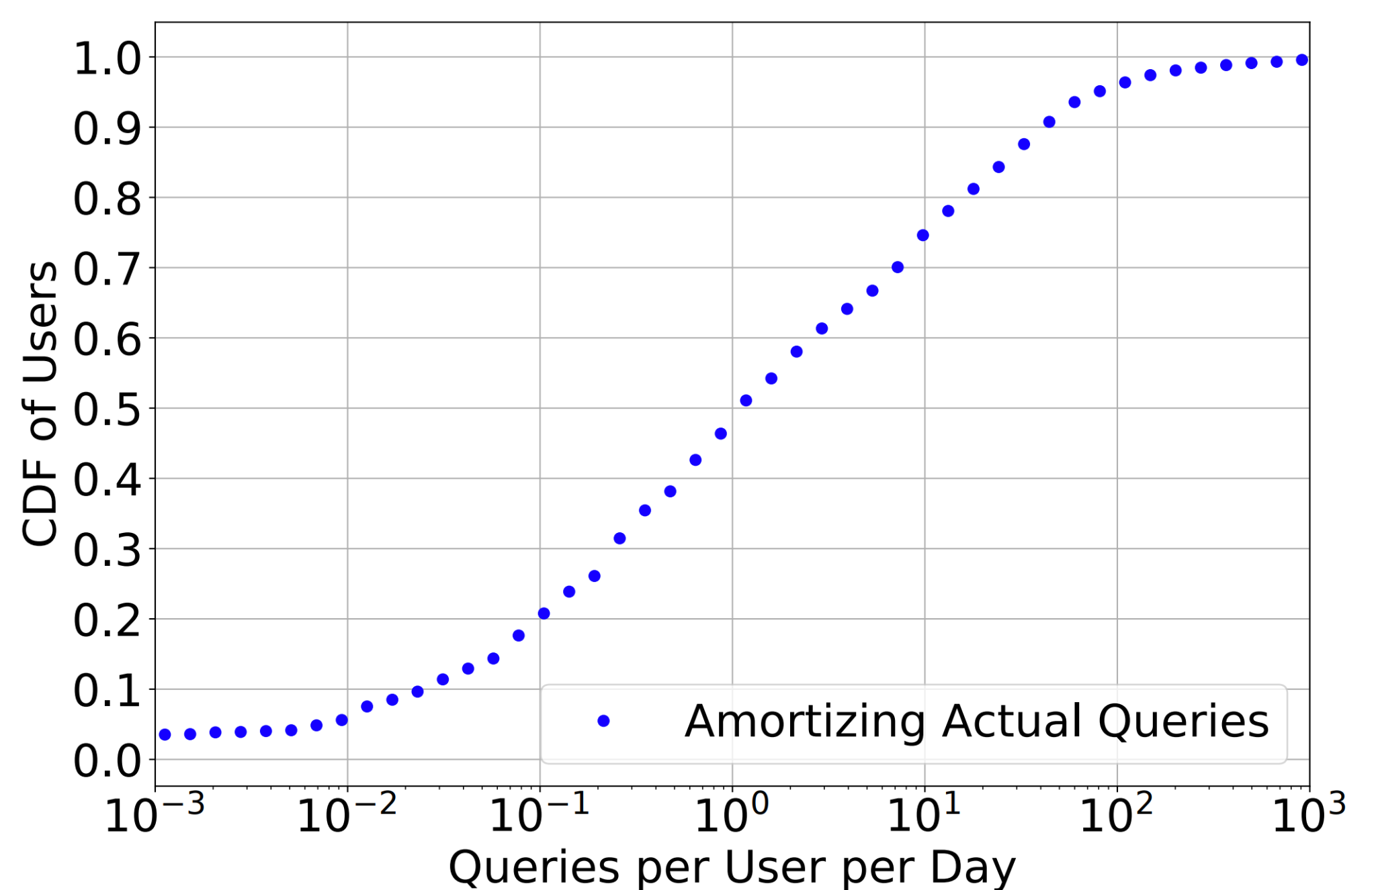
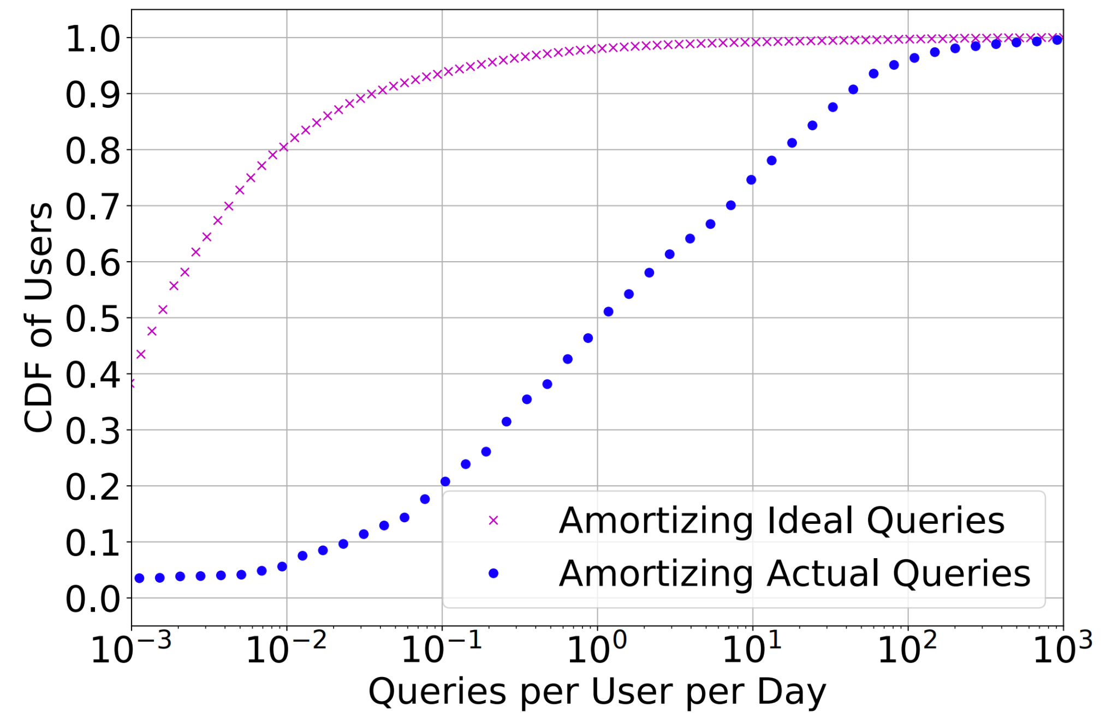
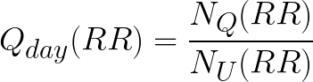
Root DNS Latency and Inflation Hardly Matter
We amortize root DNS queries over users to get queries per day.
# of queries per RR in the root traces
Med ≈ 1
# of Microsoft users using recursive
Takeaway: Most users rarely interact with the root DNS, but interact far more than one might expect.
Root latency hardly matters to users, but ‘Ideal’ shows that there are many unnecessary queries to the root DNS.
Notes:
So, to measure this impact, we looked at how users interact with the root DNS.
Recall that we have access to traces from root DNS servers, which tell us who is querying the root DNS and how often they do it. We calculate the number of queries each user makes each day by counting the number of queries seen in those traces by recursive resolvers,
and dividing daily query counts by the number of users seen using that recursive resolver by Microsoft. The numerator in the equation is the number of queries made by a recursive resolver, while the denominator is the number of users using that recursive resolver.
The figure shows queries per user per day on the x axis, and the cumulative fraction of users on the y axis. For example, the point at (.1, .2) circled in red means that 20% of users experience at most .1 queries per day to the root DNS, on average.
At the median, users execute about a query a day to the root DNS, and that’s out of all the other things you are doing on the Internet. If we’re only querying it once per day, anycast could route our queries to the root DNS around the globe, and we wouldn’t notice the difference. It would hardly affect our Internet experience. Hence root DNS latency hardly matters to users. We were surprised, however, that root DNS latency matters orders of magnitude more than one might expect if we use intuition about caching and TTLs. This is demonstrated by the ideal line, which we calculate by assuming each recursive only queries once per TTL (which is 2 days). The double sided arrow demonstrates that ideal query counts are orders of magnitude different from reality. Some experiments we conducted suggest that a large number of these “unnecessary” root DNS queries are due to software bugs in recursive resolvers. We invite you to read the paper for more information.

Slide 21
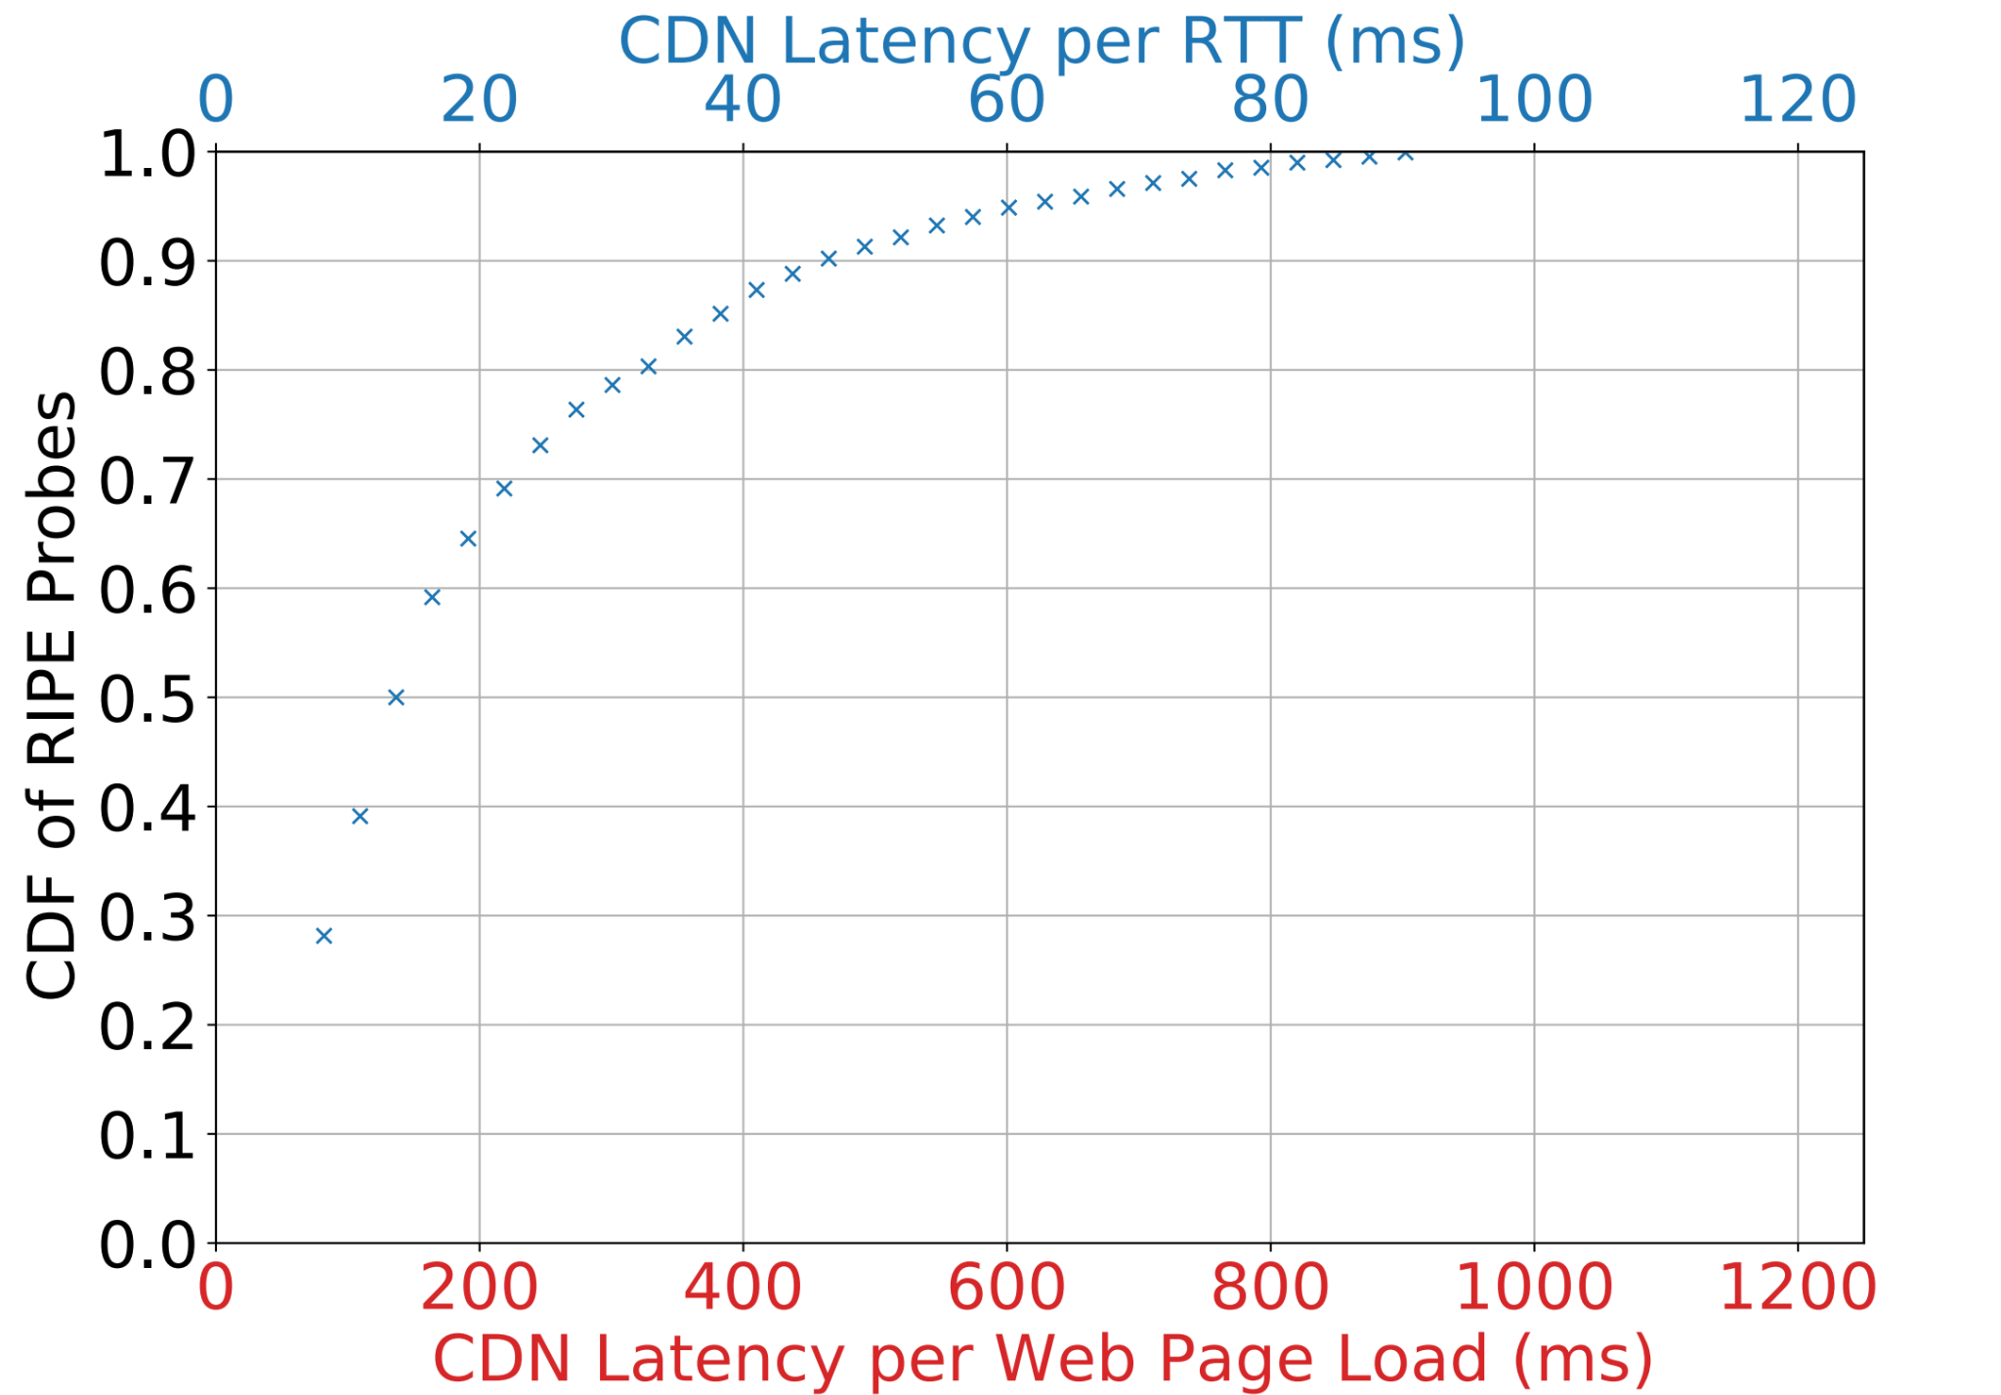
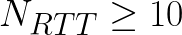
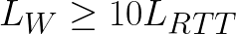
Microsoft CDN Latency and Inflation Really Matter
Number of RTTs per page load:
Latency per page load:
C Root’s Inflation
Latency Per Page Load
Latency Per RTT
Latency to Microsoft is low, but inflated paths could really hurt users!
Notes:
Conversely, in Microsoft’s CDN, we show that latency really does matter. Unlike in the root DNS, where a round trip (or RTT) is rarely incurred, we measured that users incur at least 10 RTTs when fetching Microsoft web pages. To obtain a lower bound on how much latency matters in a web page load, for example, we multiple latency per round trip by the lower bound on the number of round trips (which is 10).
The figure shows a CDF of latency per RTT for users on the top axis , and latency per web page on the bottom axis.
For example, the red circle indicates that 65% of users experience at most 20 ms per round trip or, equivalently, roughly 200 ms per page load
Latency for users is low, but inflation could hurt users significantly, since the inflation is compounded with each round trip. Recall that median latency inflation in C root, for example, was 50 ms.
Adding C roots inflation at the median would drastically increase page load times (by at least 500 ms!). Therefore, Microsoft has a much larger incentive than root DNS operators to limit inflation for users.

Slide 22
Recap
Inflation in the root DNS is large, but root DNS latency hardly matters to users, despite the news posts, studies, and growth.
On the other hand, CDN latency does matter.
And, possibly as a result, CDN inflation can be kept quite low.
Why is inflation so different?
Notes:
We’ve covered a lot of ground, so lets recap what we’ve discussed.
First, we showed that inflation in the root DNS is large (especially in individual letters), but root DNS latency hardly matters to users, despite all the attention the root DNS gets.
Conversely, we showed that CDN latency does matter and,
possibly as a result, CDN inflation can be kept quite low.
So naturally we ask, why is inflation so different?

Slide 23
Motivation
Background and Definitions
Root DNS and Microsoft’s CDN
Inflation in Anycast Deployments
Performance in Context
Investment and Incentive Shapes Deployments and Paths
Notes:
That is, we’ve talked about the ‘what’, so now let’s take a stab at the ‘why’

Slide 24
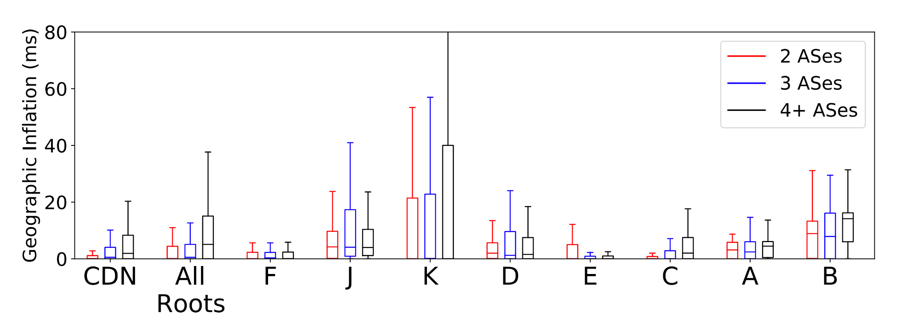
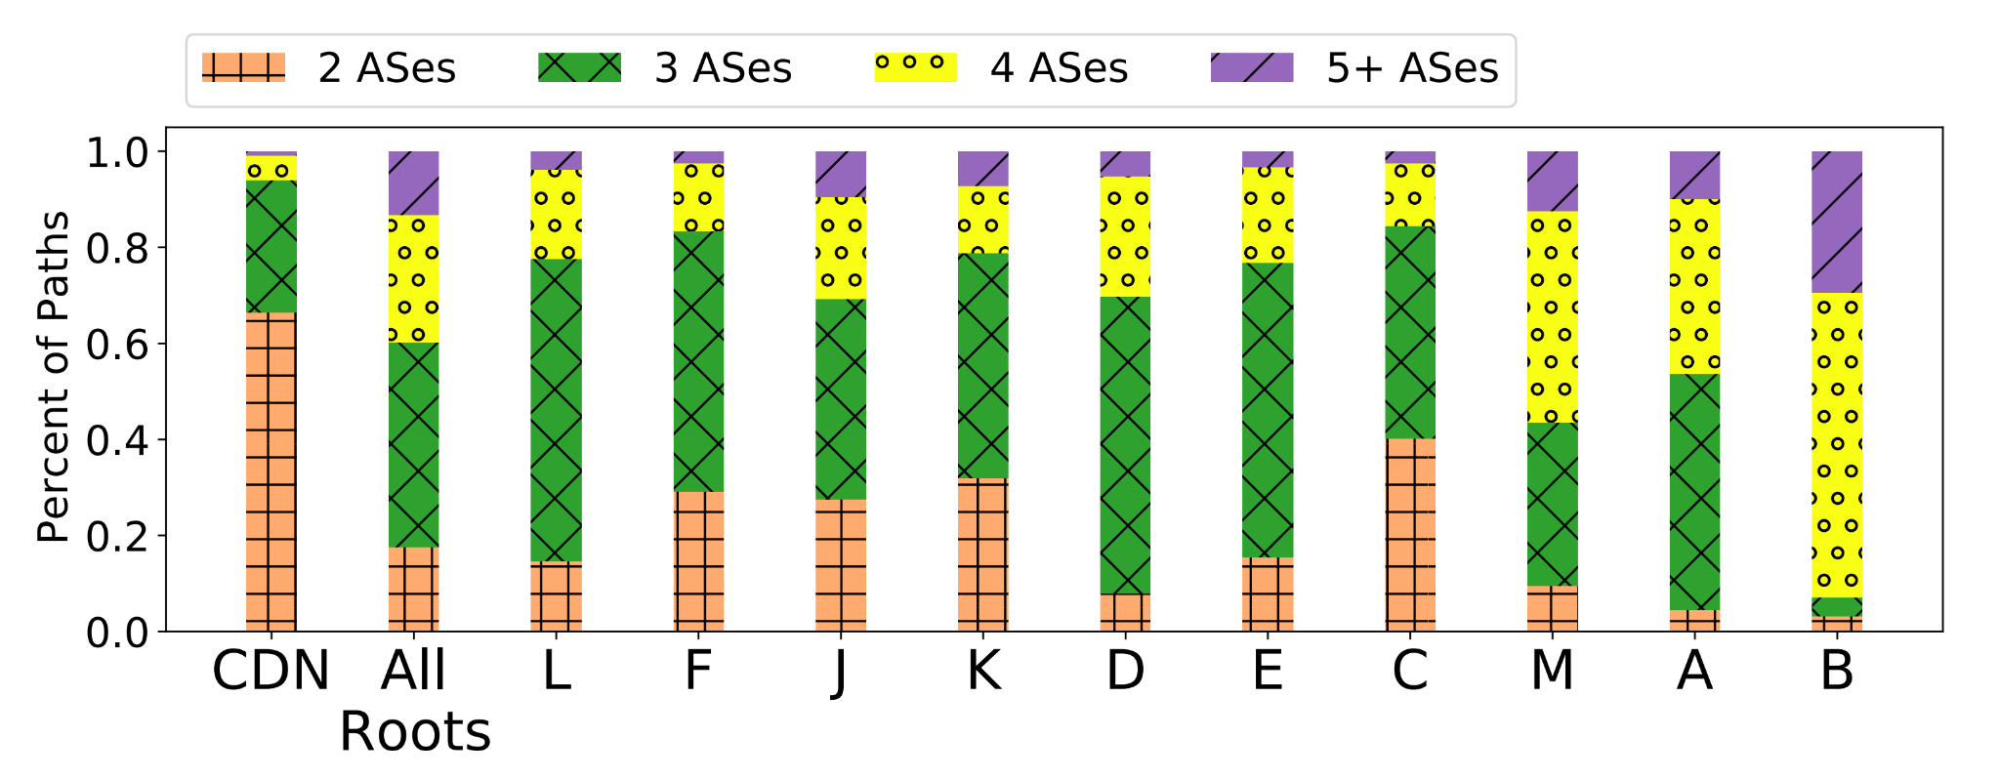
AS Paths to Microsoft are Short, & Short Paths Have Less Inflation
Direct paths sidestep the challenges of BGP: paths through peers and shorter AS paths are preferred.
Microsoft invests in expensive peering relationships, and optimizes routing.
AS Path Lengths
AS Path Length vs. Inflation
AS path lengths and correlation between AS path length and inflation, as measured from RIPE Atlas. Root letters are listed in size order.
Notes:
First, we looked at paths to Microsoft and the roots, and found that
AS paths to Microsoft are shorter. The left plot shows a bar graph of AS path lengths to each destination from RIPE Atlas probes.
For example, 63% of paths to Microsoft are direct connections, but only 15% of paths to the root DNS are direct connections as highlighted by the red circles.
The right plot shows that shorter AS paths have less inflation so it seems that the short paths on the left plot are helping Microsoft control inflation. To obtain the right plot, we plot the inflation RIPE Atlas probes experience in a box and whisker, sorted by the AS path length to each destination.
For example, the ‘CDN’ and ‘All Roots’ whiskers show that paths of length 2 have less inflation than paths of length 3 and 4. The trend is not absolute across all root letters, likely since deployment and routing strategies play roles in inflation as well. So, why are paths to Microsoft paths shorter? And why do shorter paths have less inflation?
Microsoft directly connects to networks, sidestepping the challenges of BGP we mentioned -- that is, BGP does not take performance into account in its decision making process. Direct paths through peers and shorter AS paths are preferred in the BGP decision process, and so Microsoft can more directly optimize for performance. Optimizing BGP advertisements to reduce inflation, and peering with end user networks to shorten AS paths, takes a lot of time and money. This expense doesn’t really make sense for roots since latency hardly matters.

Slide 25
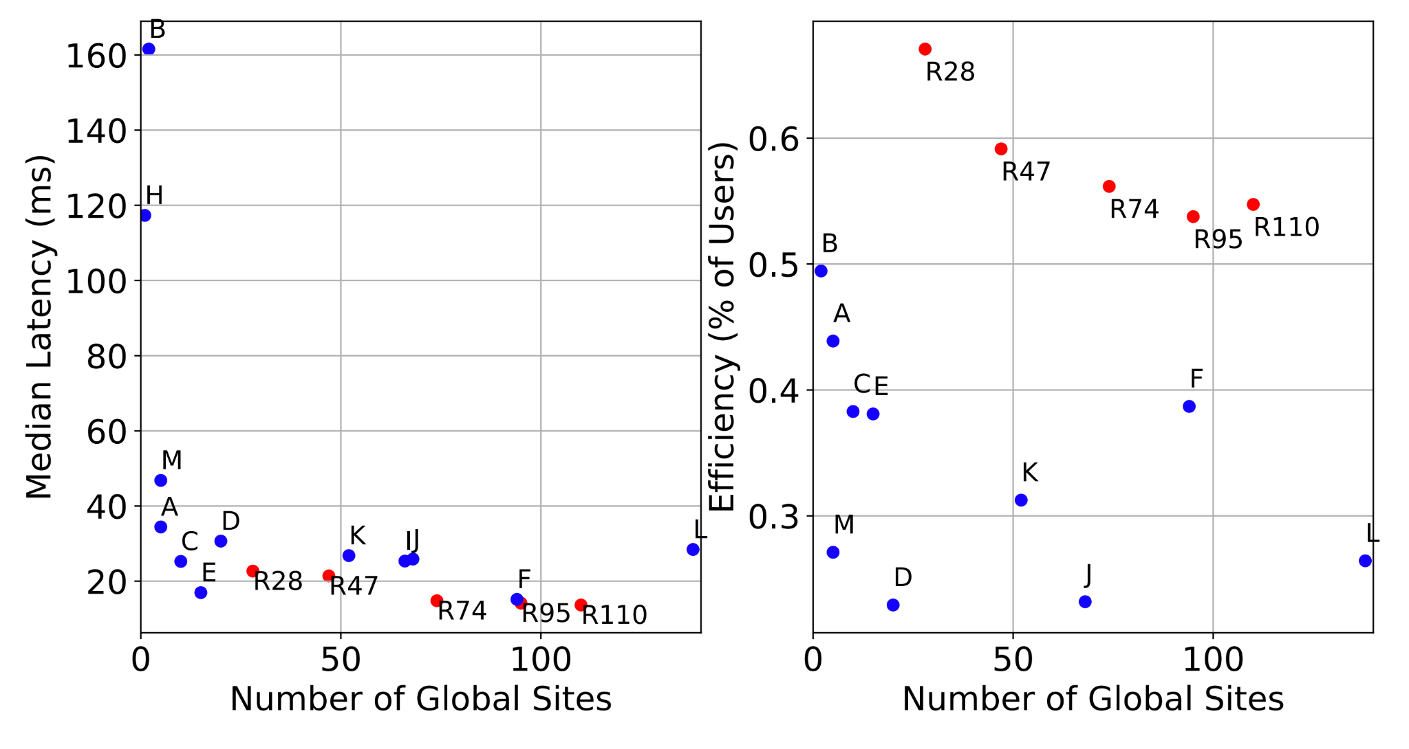
Larger Deployments Lower Latency and Efficiency
Although fewer users visit their closest site in larger deployments, the site users do hit is still pretty close.
Having low latency options is more important than hitting the closest site.
Efficiency is a misleading metric!
Efficiency is the percent of users that visit their closest site. Larger deployments offer lower latency, but are less efficient.
Notes:
So, if more sites makes it easier for BGP to inflate paths, why expand deployments? Let’s look at the interplay between deployment size, latency, and efficiency. The left plot shows median latency to root letters and to Microsoft rings as deployment size increases, while the right plot shows deployment efficiency as deployment size increases. We approximate deployment efficiency as the percent of users hitting their closest site in that deployment.
Overall, we find that latency decreases with deployment size (since users have more low latency options) which is shown by the decreasing trend on the left plot. Also, we find efficiency is a misleading metric for “goodness” of a deployment since users may still hit a relatively close site.
For example, the yellow arrows point to B root which has high efficiency but also has pretty high latency.
The red arrows pointing to L root show that L root has low efficiency and low latency. Microsoft’s and the root DNS deployments have grown considerably in the past 5 years. Some have argued that larger deployments are not as efficient, since users are more likely to be directed to suboptimal sites. Hopefully the discussion here illustrates that having low latency options is much more important than hitting the closest site, which is likely why deployments continue to expand.

Slide 26
Anycast Deployment Comparison
 | Property
 | Total Sites | Sites per Deployment | Prefix to Site Assignments | Connectivity per Site | RTTs per Content Fetch | Optimization Strategy
Microsoft | 110 | 30-110 (regulatory restrictions) | By application | Multiple Transit, 100s of Peers | At least 10 | Peering widely, Global WAN
Akamai DNS | Hundreds | 25 (spread load, redundancy) | For performance | 1 Transit 1- 15 Peers | Probably Less than One | Intricate, automated optimization
Root DNS | 1400 | 6-250 (different orgs, same service) | By root letter | Various | Hardly Any | Caching with long TTLs
 | Property
 | Total Sites | Sites per Deployment | Prefix to Site Assignments | Connectivity per Site | RTTs per Content Fetch | Optimization Strategy
Microsoft | 110 | 30-110 (regulatory restrictions) | By application | Multiple Transit, 100s of Peers | At least 10 | Peering widely, Global WAN
Akamai DNS | Hundreds | 25 (spread load, redundancy) | For performance | 1 Transit 1- 15 Peers | Probably Less than One | Intricate, automated optimization
Root DNS | 1400 | 6-250 (different orgs, same service) | By root letter | Various | Hardly Any | Caching with long TTLs
 | Property
 | Total Sites | Sites per Deployment | Prefix to Site Assignments | Connectivity per Site | RTTs per Content Fetch | Optimization Strategy
Microsoft | 110 | 30-110 (regulatory restrictions) | By application | Multiple Transit, 100s of Peers | At least 10 | Peering widely, Global WAN
Akamai DNS | Hundreds | 25 (spread load, redundancy) | For performance | 1 Transit 1- 15 Peers | Probably Less than One | Intricate, automated optimization
Root DNS | 1400 | 6-250 (different orgs, same service) | By root letter | Various | Hardly Any | Caching with long TTLs
 | Property
 | Total Sites | Sites per Deployment | Prefix to Site Assignments | Connectivity per Site | RTTs per Content Fetch | Optimization Strategy
Microsoft | 110 | 30-110 (regulatory restrictions) | By application | Multiple Transit, 100s of Peers | At least 10 | Peering widely, Global WAN
Akamai DNS | Hundreds | 25 (spread load, redundancy) | For performance | 1 Transit 1- 15 Peers | Probably Less than One | Intricate, automated optimization
Root DNS | 1400 | 6-250 (different orgs, same service) | By root letter | Various | Hardly Any | Caching with long TTLs
 | Property
 | Total Sites | Sites per Deployment | Prefix to Site Assignments | Connectivity per Site | RTTs per Content Fetch | Optimization Strategy
Microsoft | 110 | 30-110 (regulatory restrictions) | By application | Multiple Transit, 100s of Peers | At least 10 | Peering widely, Global WAN
Akamai DNS | Hundreds | 25 (spread load, redundancy) | For performance | 1 Transit 1- 15 Peers | Probably Less than One | Intricate, automated optimization
Root DNS | 1400 | 6-250 (different orgs, same service) | By root letter | Various | Hardly Any | Caching with long TTLs
Deployment
Notes:
Let’s compare three anycast deployments: Microsoft, Akamai DNS, and the root DNS. Although we don’t discuss Akamai DNS in our paper, we feel its important to compare since there is a talk about it at SIGCOMM 2021, and there are key differences. Let’s look at the first 3 columns. Akamai assigns IP addresses to sites to optimize performance and promote resilience, with only 25 / hundreds of sites given one IP address. The distinguishing factor between Microsoft’s anycast deployments is regulatory, and so the prefix to site assignments are related to the applications each site hosts. The root DNS assigns prefixes to sites by root letter, and all sites in a root letter advertise the same prefix.
These services have different connectivity -- Microsoft has multiple transit providers per site and peers with hundreds of end user networks. Akamai has one transit provider per site and between 1 and 15 peers per site. Root DNS connectivity varies among root letters, since they are run by different organizations with different strategies and budgets.
The three services serve content with different latency requirements which we approximate with ‘round trips per content fetch’. Users fetching Microsoft content incur at least 10 RTTs, so inflation really hurts. Queries to Akamai DNS occur more often than in the root DNS since they host more DNS records and have shorter TTLs, but caching and small content size still implies users probably will incur (on average) less than an RTT when fetching content. Queries to the root DNS rarely occur due to caching.
Because of all these differences, the three deployments optimize performance in different ways which we summarize in final column ‘Optimization Strategy’. Microsoft invests in peering, optimizes route announcements, and leverages its global WAN; Akamai uses intricate optimization algorithms that assign certain prefixes to certain sites; recursive resolvers rely on caching to deliver performance benefits to users in the root DNS.

Slide 27
Can CDNs like Microsoft’s Benefit From AnyOpt [1]?
Scaling issues prevent application.
Lots of sites and multiple transit providers per site.
The paper admits that the methodology does not yet scale.
Lots of peers, which are the preferred connection.
But the insights from AnyOpt are still valuable.
Many principles in AnyOpt are general and, if further developed, may be useful for anycast CDNs similar to Microsoft’s.
[1] AnyOpt: Predicting and Optimizing IP Anycast Performance. Zhang, Xiao and Sen, Tanmoy and Zhang, Zheyuan and April, Tim and Chandrasekaran, Balakrishnan and Choffnes, David and Maggs, Bruce M. and Shen, Haiying and Sitaraman, Ramesh K. and Yang, Xiawei. In Proceedings of the 2021 SIGCOMM Conference. Online.
Notes:
A question we might ask about AnyOpt, the paper appearing in the same SIGCOMM session describing a technique to optimize anycast deployments, is whether the methodology it presents can be used to improve anycast CDNs such as Microsoft’s.
(DOUBLE CLICK)
Unfortunately, the answer is likely ‘no’.
AnyOpt likely doesn’t scale to deployments of Microsoft’s size,
including the number of sites and the number of providers.
Microsoft also has many more peers, and AnyOpt’s support for optimizing over peering connections is limited.
But we still find the insights in their paper very valuable.
Anycast CDNs will always be trying to optimize their deployments. AnyOpt has opened many avenues for research, which may lead to practical anycast optimization frameworks for other anycast networks. PAUSE

Slide 28
Conclusions
One should assess anycast in context of the system.
Generalizing root DNS to other applications can be misleading.
Comparing root DNS latency and anycast inflation is unproductive.
Root DNS operators should not deploy new sites to lower latency.
Inflation is a misleading metric -- absolute latency is more important.
Anycast deployments can be engineered to keep latency low.
Notes:
Recall that we began this investigation because of prior work that assessed anycast out of the context of its deployment (the root DNS). Hence, our major conclusion is that anycast must be assessed IN CONTEXT,
and we must understand how that context can shape performance.
In particular, root DNS latency hardly matters to users, so we should stop focusing on it
and deploying to reduce it.
Moreover, inflation can be a misleading metric, since absolute latency is more important,
and anycast deployments can be engineered to keep latency low, despite the presence of some inflation.

Slide 29
Rough Outline
Overview to give folks the gist
Prior work has painted anycast in both good and bad lights. The bad especially doesn’t make sense since anycast is used more and more (growing deployments), in latency-sensitive applications.
We resolve the discrepancy by investigating anycast in the context of the system in which its used -- how does latency translate to users?
We show anycast performance is good when it matters to users, and is generally better than previously thought.
Motivation -- anycast has been perceived in good and bad lights, using different methodology. So we don’t know what to think.
Give numbers of growing deployments -- why are they growing if performance is poor?
Give example of conflicting takeaways from prior work -- lots of inflation in C root (UMD paper), not so much in Microsoft’s CDN.
Discuss how they use different methodology / coverage, so it’s difficult to see what is going on.
Not too much detail
Contributions
Definitions of anycast, inflation, comparison to prior work, why we chose these measures of inflation in particular.
Descriptions of the two systems we study, the data we use.
Inflation (gist for 12 minute, longer for 25 minute)
Geographic and latency inflation in root DNS.
Geographic and latency inflation in CDN.
How users experience latency
Why and how we analyze how often users interact with root DNS (versus just relying on intuition).
Interaction with root DNS at ISI and for the two author computers.
Queries per day for root DNS, latency per page load for CDN -> need to reduce inflation leads to low inflation
Why is inflation different
Routing comparison
Interplay between deployment size, latency, efficiency
Are root DNS operators concerned about latency? (survey results)
Notes:
For the hook, quotes from the two different papers would be cool
Insert a 1.5 -- define anycast, BGP (ekb: I think it can be 2.5, maybe -- I was thinking of it as part of 4, but swapping the order of 3 and 4)
Show definitions using figures to make them less dry and more informative
Insert a 4.5 -- our contributions are …
(--or-- a 2.5 if you make it flow well)
For the 12 minute talk, a nice thing to do is have a slide that says what you’re not talking about in the presentation
Root interactions per day and routing comparison are some of the more interesting points, include other points for longer version
For author computers and ISI, confirm with a bullet you don’t say
*****Differentiate the Microsoft deployment from Akamai’s deployment, since it comes a few presentations later
Page numbers

Slide 30
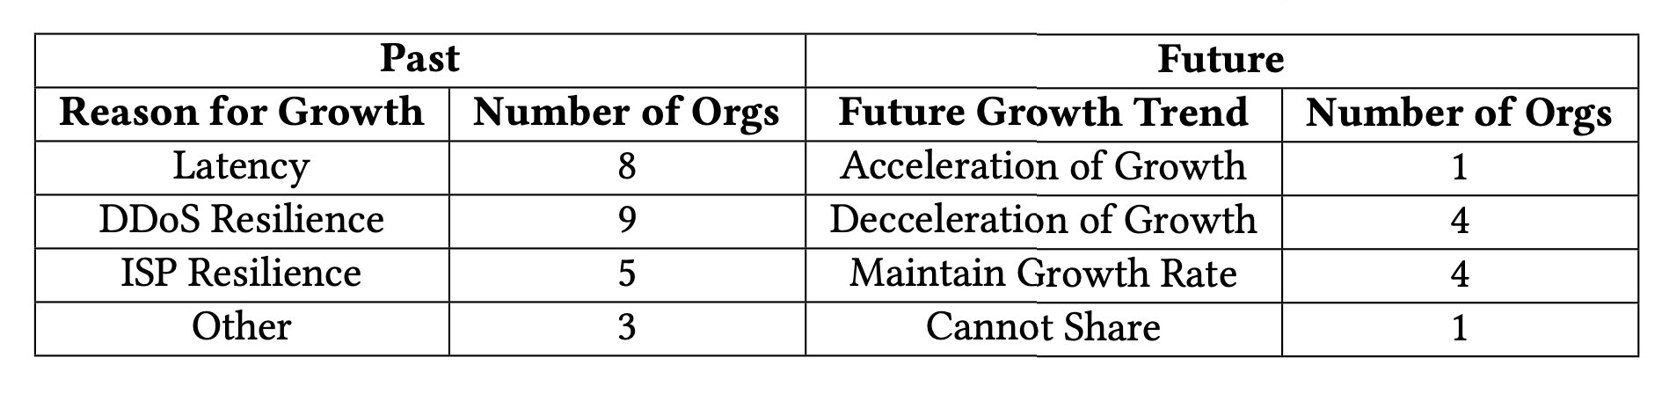
What Caused All the Growth?
We asked root DNS operators why they expanded, and whether the expansion will continue.
Surprisingly, many listed decreasing latency as a reason for expanding.
Expansion will likely slow.

Slide 31
Comparison to Akamai DNS Anycast Deployment
Number of PoPs & Available Sites - Akamai has hundreds of sites. Queries for Akamai DNS-hosted domains are served by subsets of sites. There are 24 anycast deployments, each consisting of about 25 sites. - Microsoft has 110 sites. Queries to Microsoft can reach any site, given legal regulations.
PoP Prefix Assignments - For Akamai DNS, prefixes are assigned to sites to spread load, enhance resiliency, and optimize performance, with no more than 2 prefixes per site. - For Microsoft, different services have different regulatory requirements. Each level of regulatory requirement has its own anycast prefix, and all sites that meet the requirement advertise that prefix. The smallest set (most stringent requirements) is 28 sites, roughly the same size as an Akamai anycast deployment.
Connectivity of Sites - Akamai has only one transit provider per site, and peers at each site number in the teens. - Microsoft has multiple transit providers per site for resilience, and peers at each site number in the hundreds.
Notes:
Before our concluding thoughts, lets discuss Akamai DNS’ anycast deployment (even though its not in our paper). We feel that it’s necessary to explicitly highlight the differences between Akamai’s anycasted DNS service and Microsoft’s anycast CDN, since there is a talk about it soon, there are key differences, and their talk is about optimizing an anycast deployment which is very relevant.
We’ve identified some differences that we think are the most important. First, Akamai’s deployment has hundreds of sites. It’s deployment is actually 24 individual anycast deployments, each consisting of about 25 sites. Microsoft only has 110 sites, but queries to Microsoft can reach any of these sites, aside from regulatory restrictions.
Second, Akamai assigns prefixes to sites to spread load, enhance resiliency and optimize performance with no more than 2 prefixes per site. But Microsoft only considers regulatory requirements when assigning prefixes to sites. All sites that meet sufficient regulatory requirements advertise the corresponding prefix. The smallest set (which has the strictest requirements) is 28 sites, roughly the same size as an Akamai anycast deployment.
Finally, Akamai DNS and Microsoft have very different connectivity. Akamai has only one transit provider per site, and only has tens of peers. Microsoft has multiple transit providers and peers at each site number in the hundreds.

